Slide 1
The Comfy Bridge
By Audrey Kilpatrick & Melanie Nieves

Slide 2
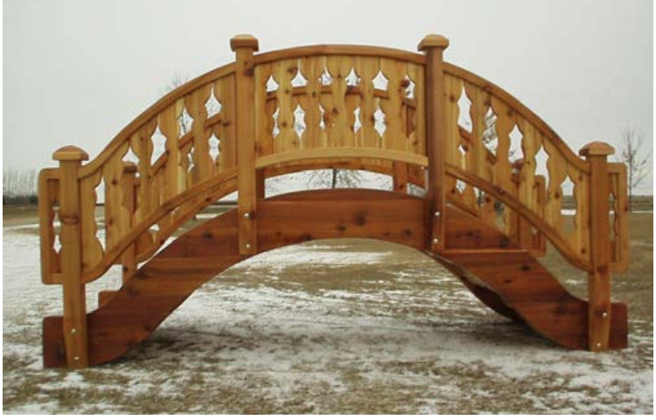

Slide 3
The basic purpose of montessori furniture is to have multiple learning components and save space in the classroom. We decided to do a bridge that contains storage for different purposes, whether it's books, supplies or miscellaneous objects, that also contains a comfortable area to attract students.

Slide 4
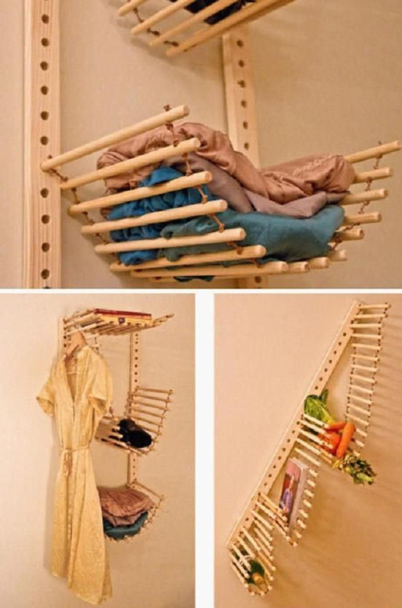
Precedents

Slide 5
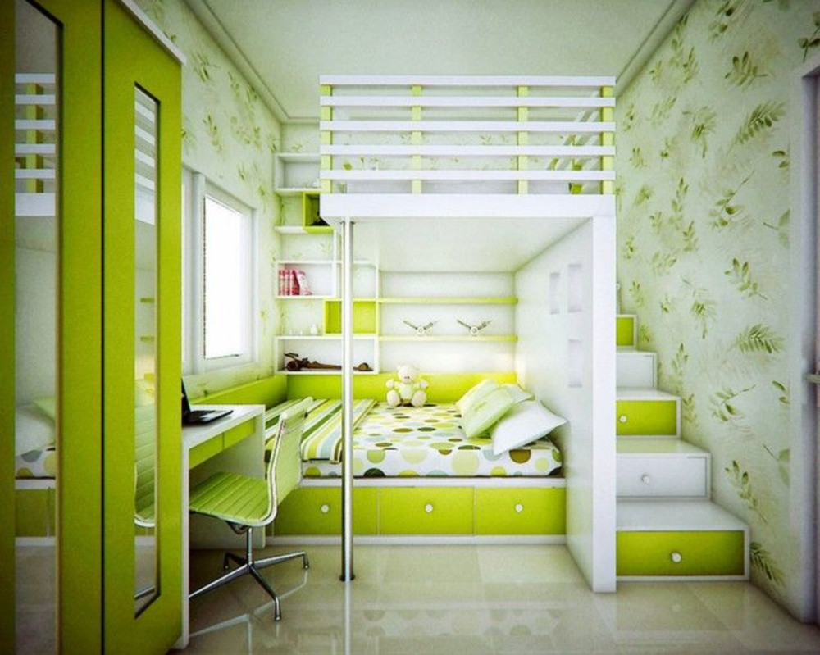

Slide 6
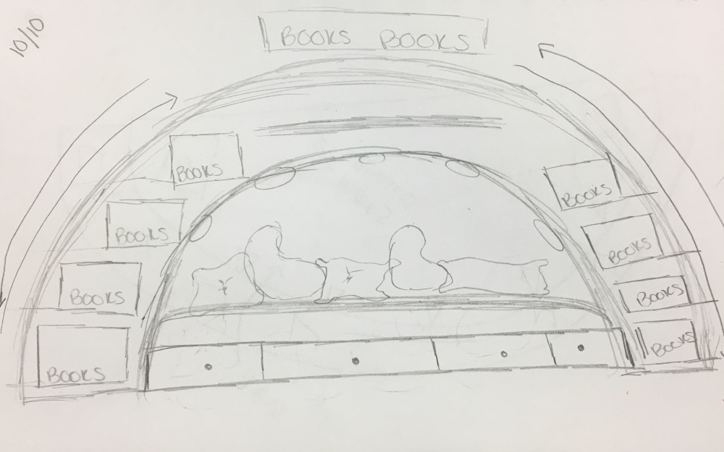
Sketch

Slide 7
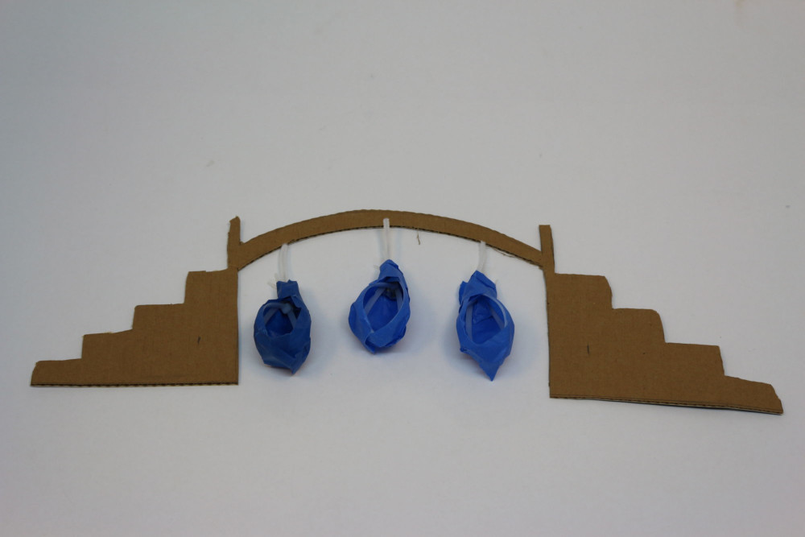
Iterations

Slide 8
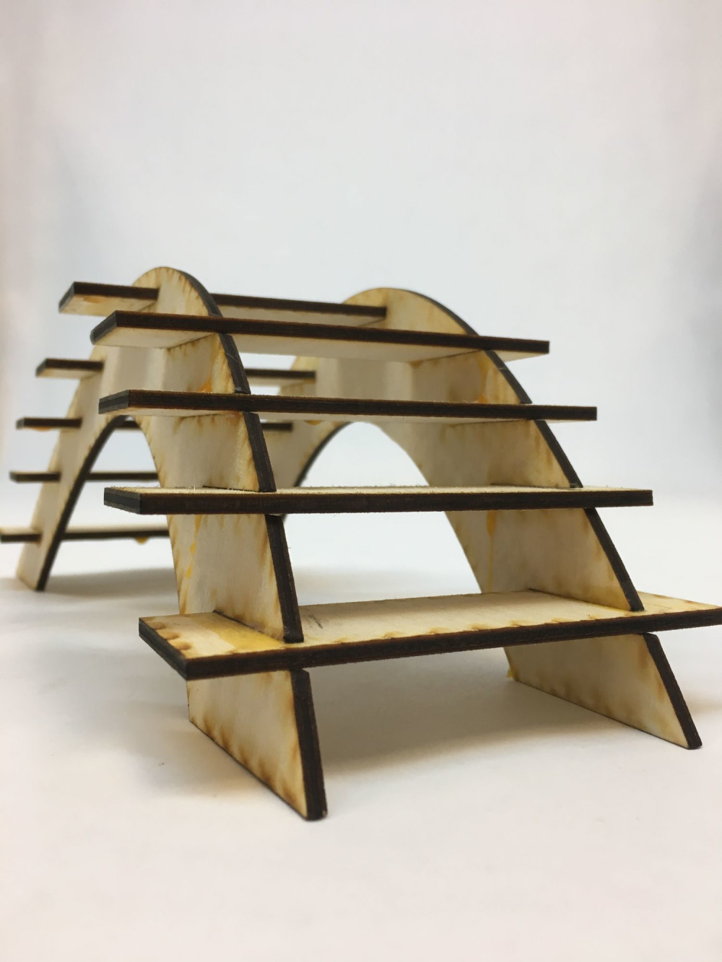

Slide 9
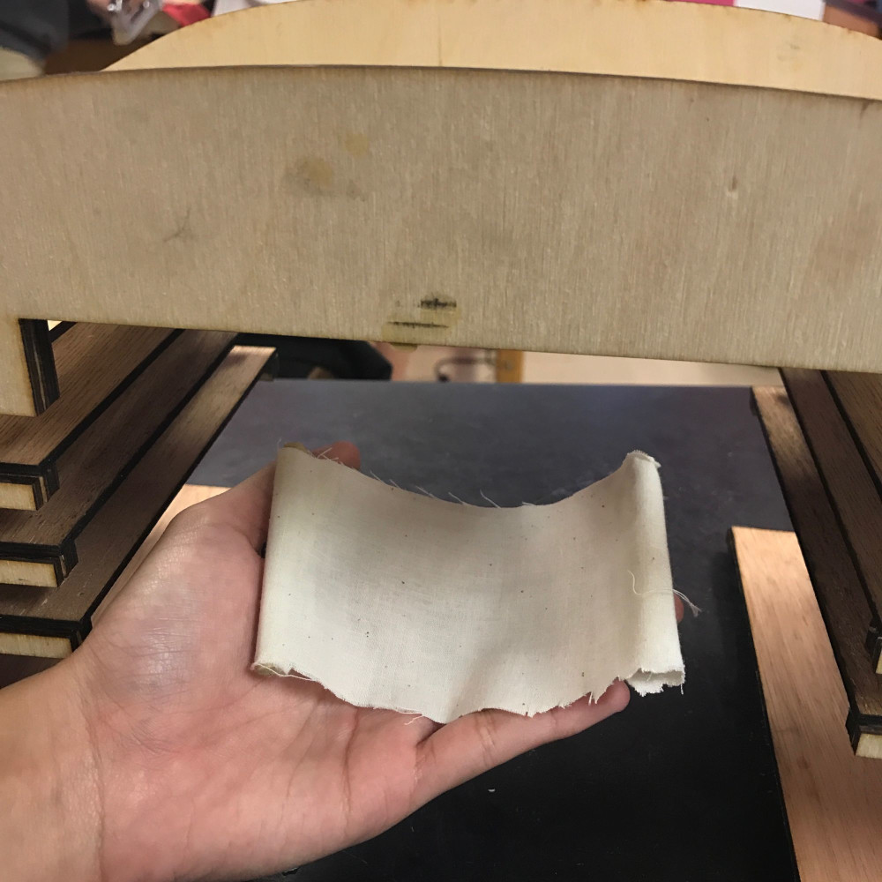

Slide 10
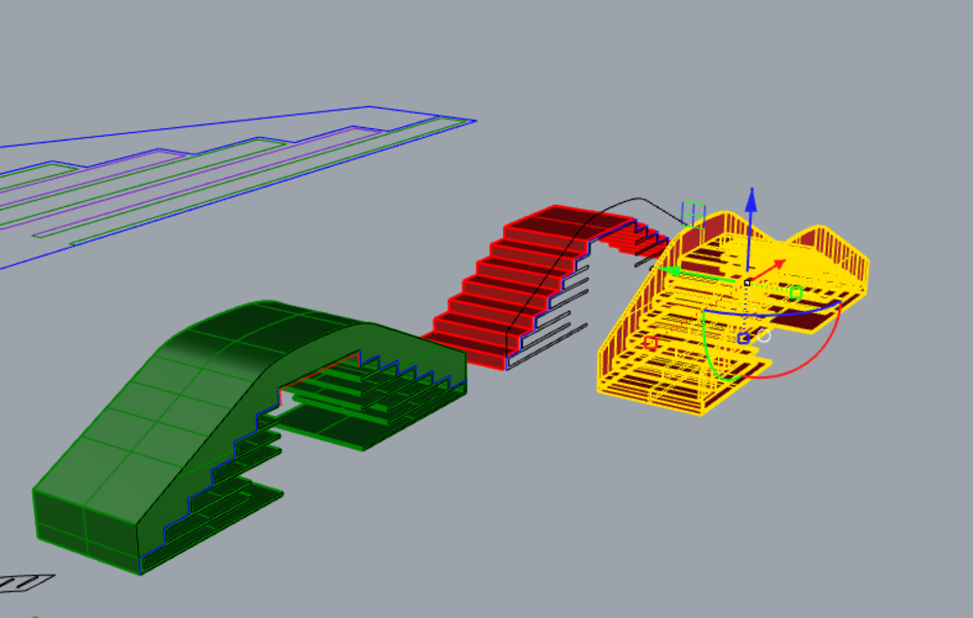
Diagrams

Slide 11
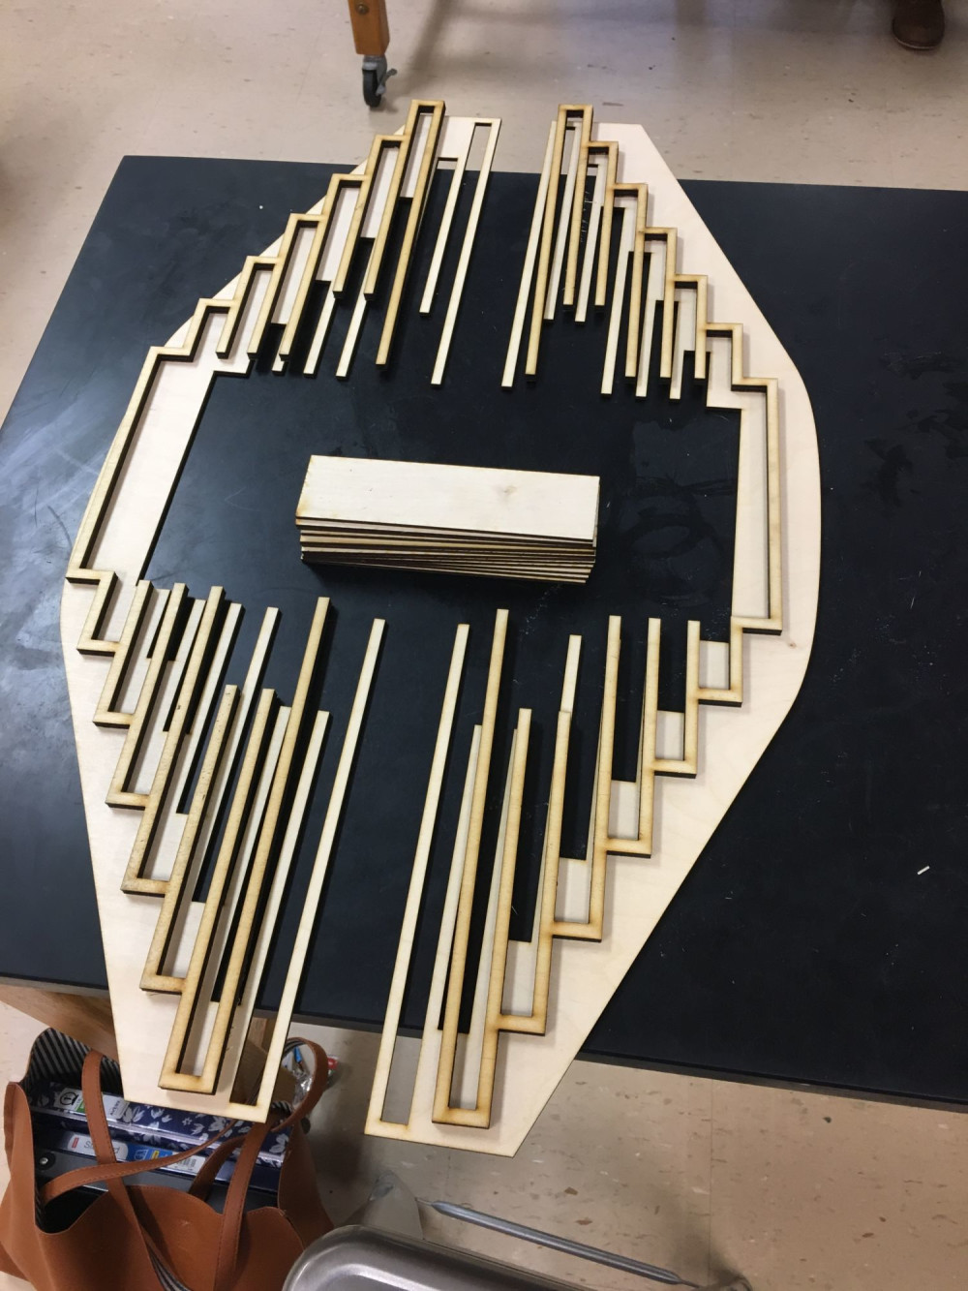

Slide 12
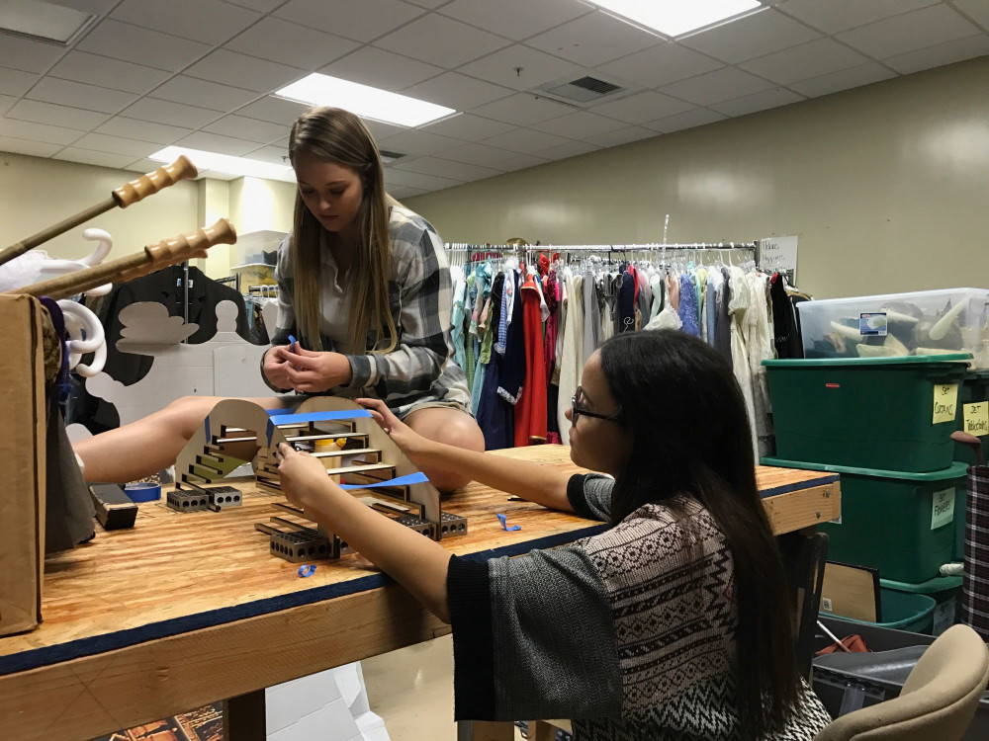

Slide 13
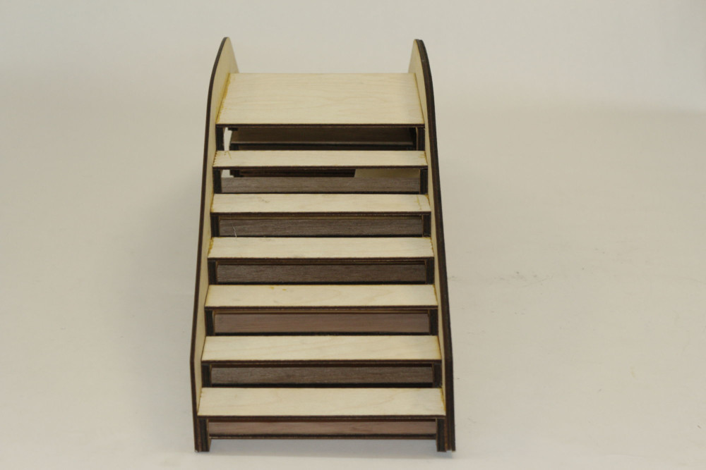
Final Images

Slide 14
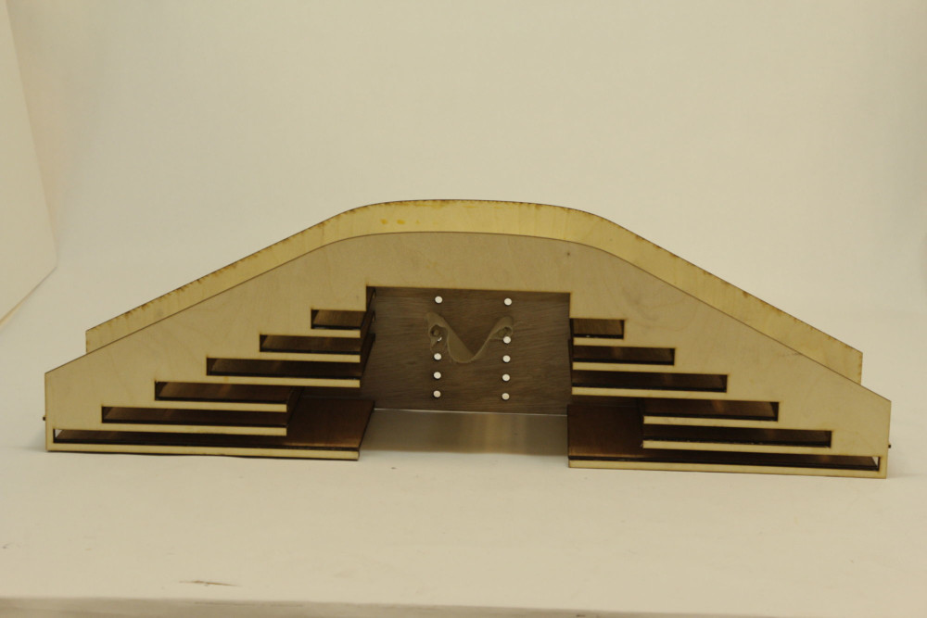

Slide 15
