Slide 1
Guerrilla charging station
Arissa Li & Tom Liu

Slide 2
Problem:
Recharging electronic devices is a huge problem for refugees. They only have limited access now to one or two chargers per group of people. The complicated wires have been an issue which bring inconvenience and danger to them for long time.

Slide 3
Goal:
We wish to invent a movable charging station for refugees to solve this problem. It was actually the sun which inspired us. Solar energy is renewable. It would be a perfect source of energy if it can be applied to the charging station.

Slide 4
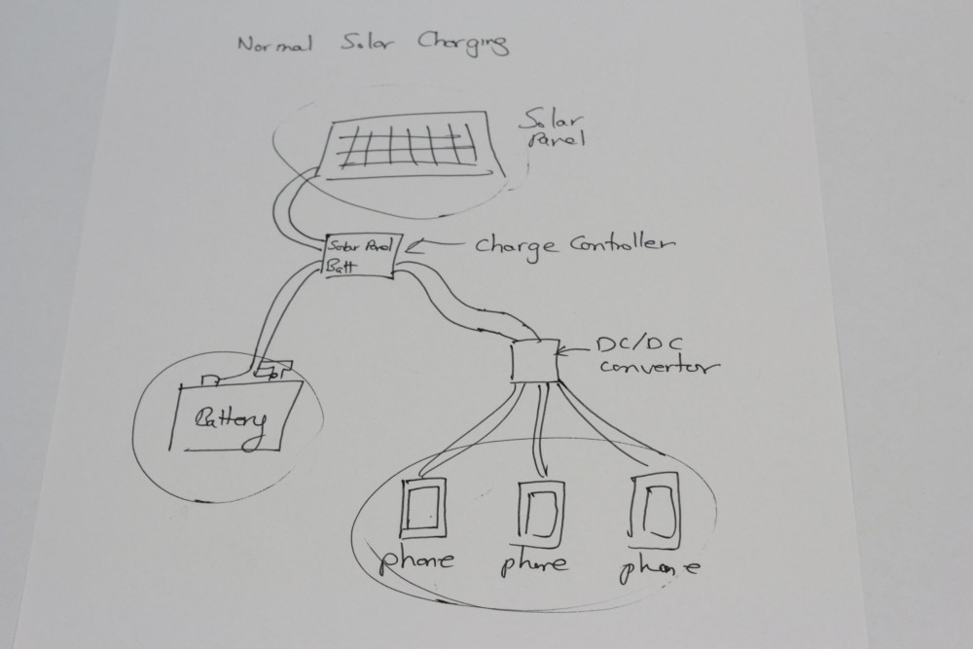
We need solar panels, charge controller, Dc converter and battery.

Slide 5
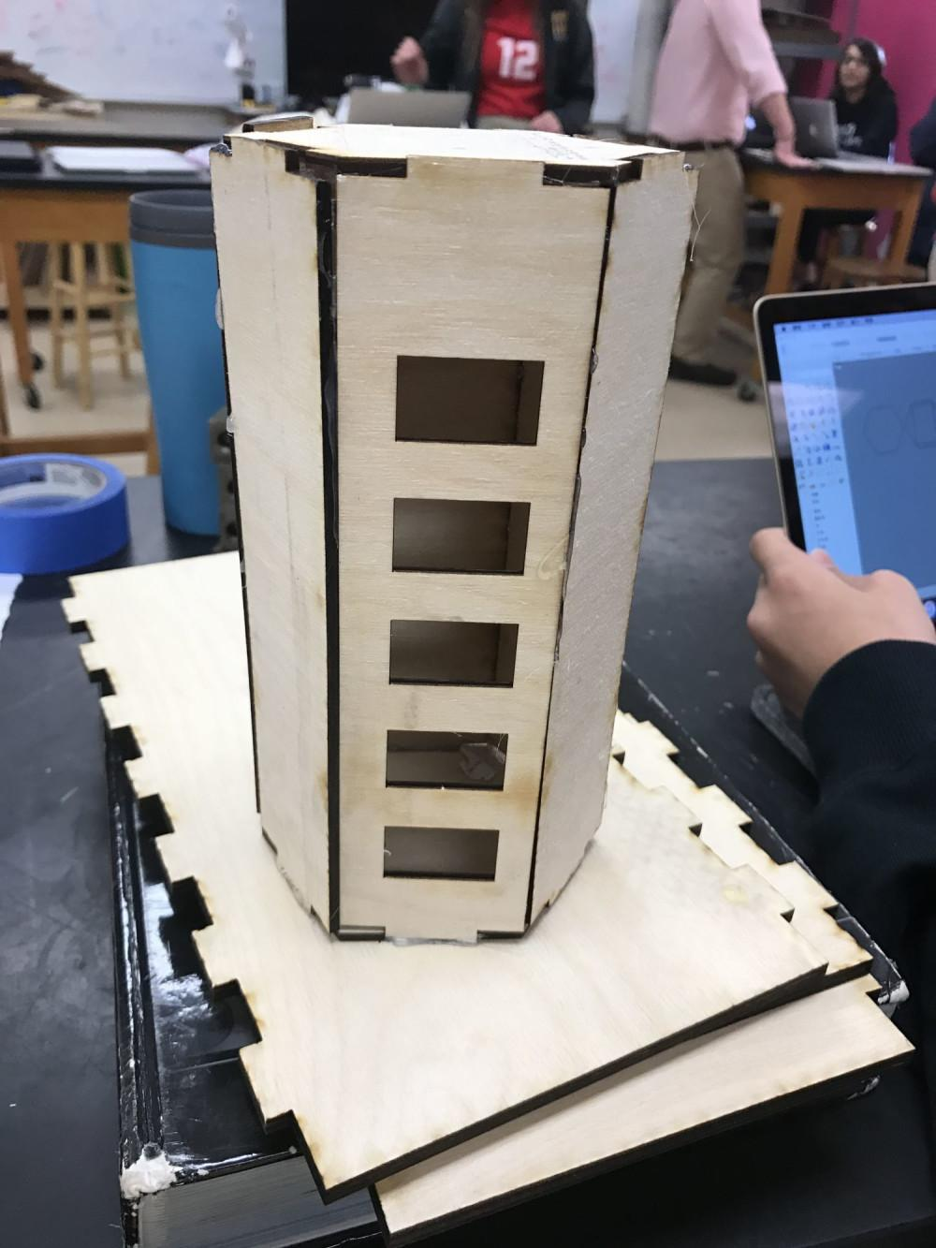
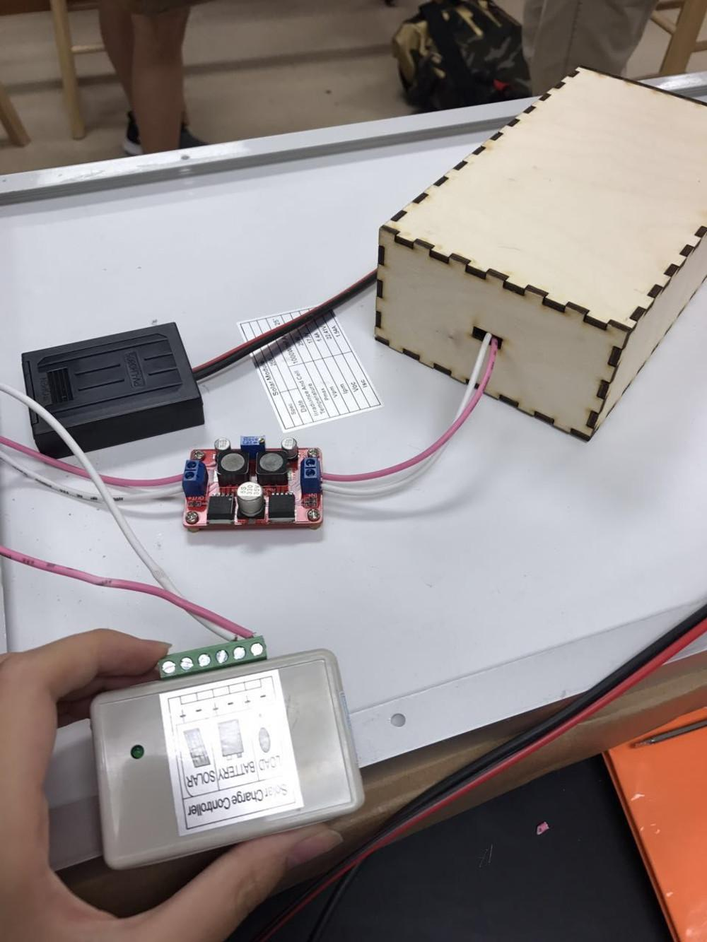
Model of charging station and locker.

Slide 6
