Slide 1
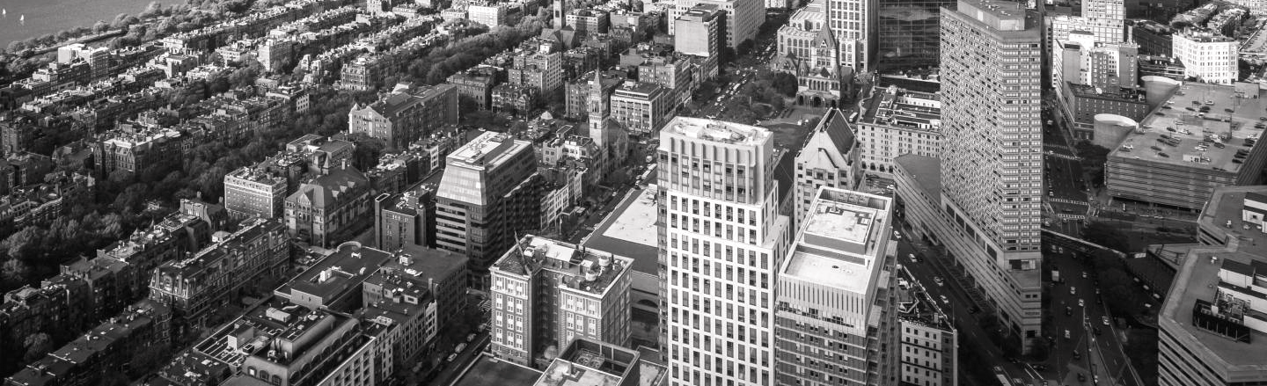
THE
BIO-ACTUATION
CHIARA BLISSETT
INTERACTIVE
INTERFACE

Slide 2
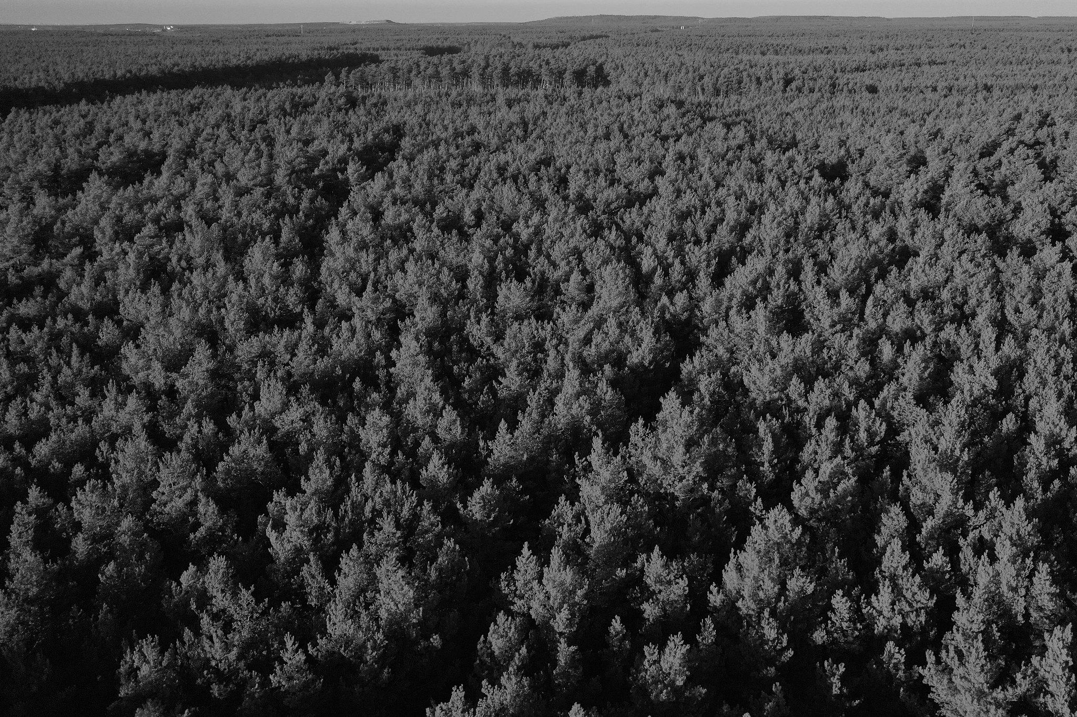
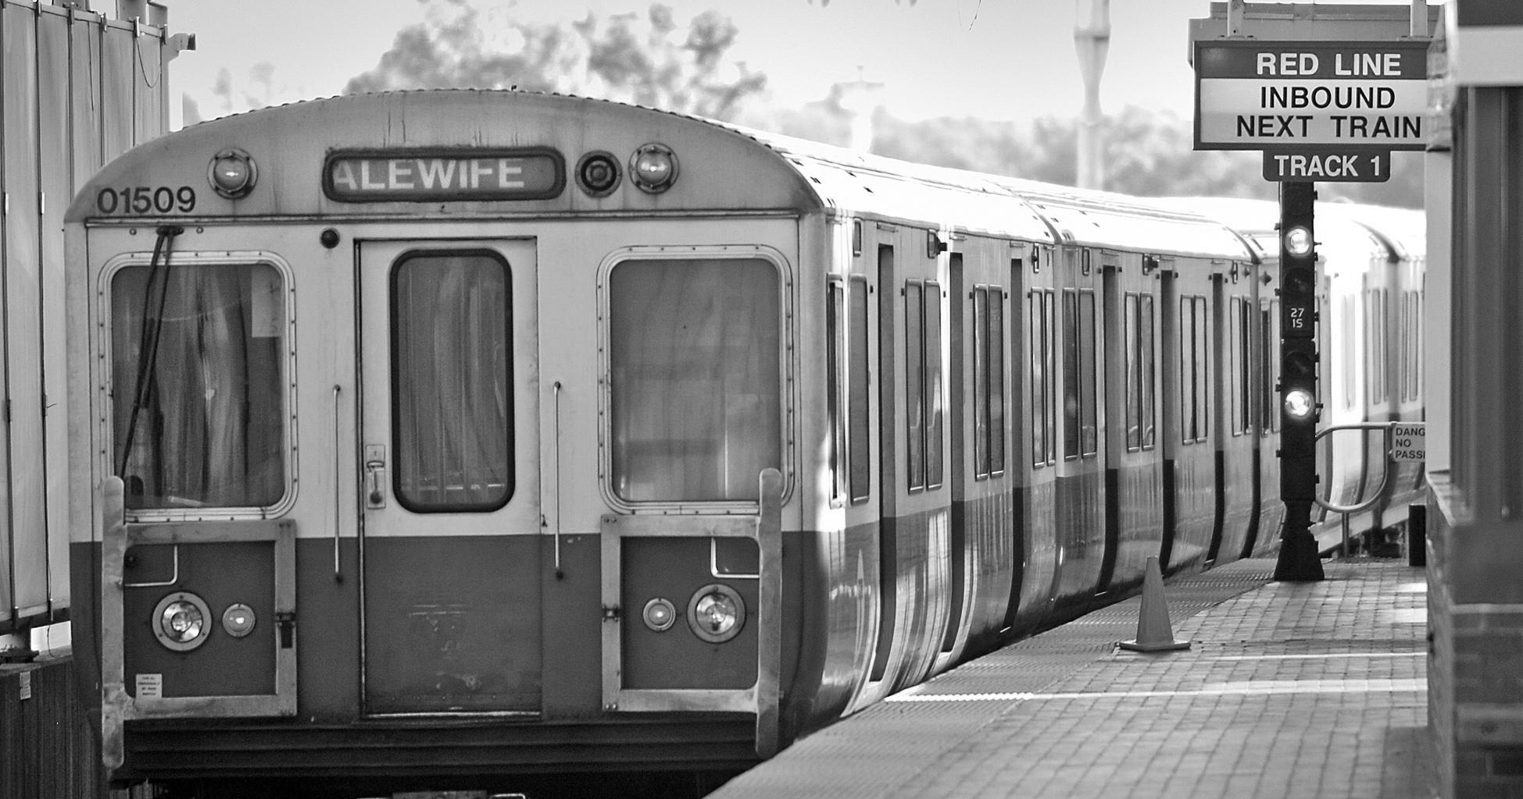
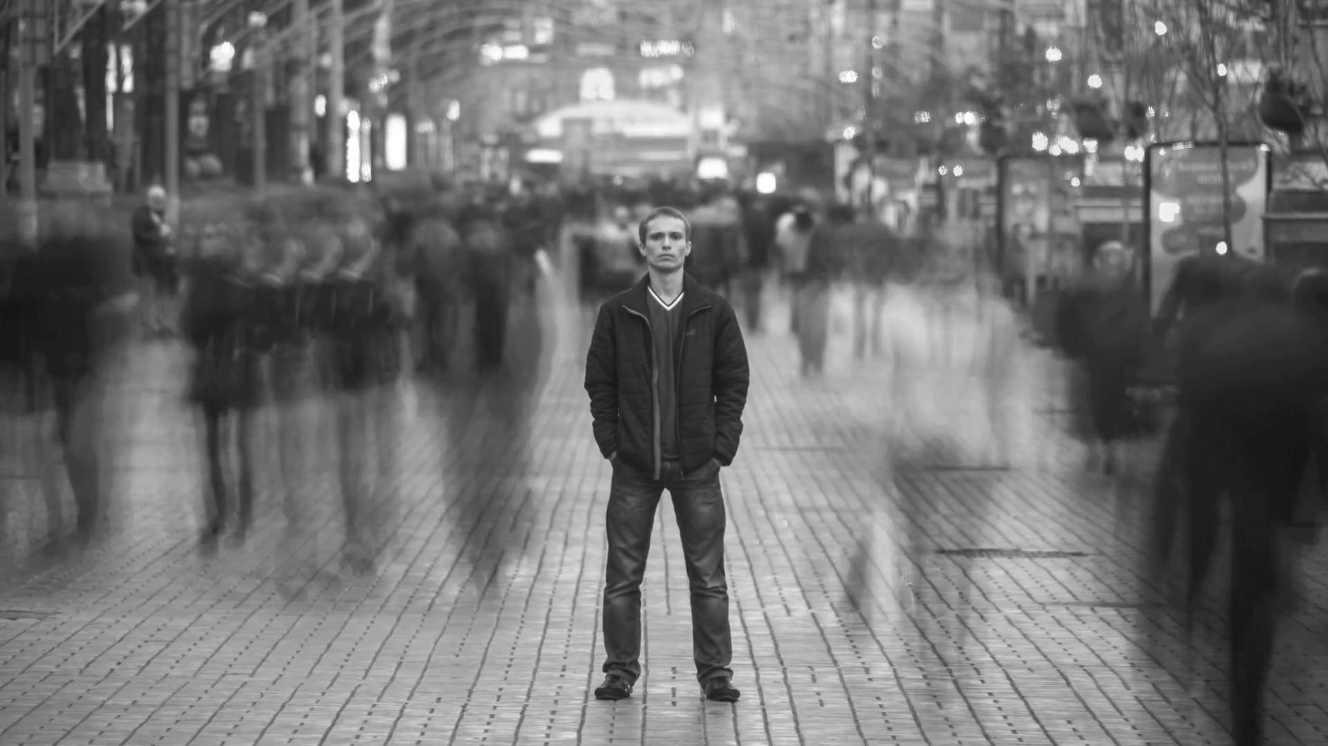
SONDER
The realization that each passerby has a life as vivid and complex as your own.
TRAINS

Slide 3
URBAN ENVIRONMENTS LIMIT US — WHY NOT EXPAND THOSE LIMITS?
Intro
My exploration of redefining ‘normal’ urban spaces and making them recognize individual existence.

Slide 4
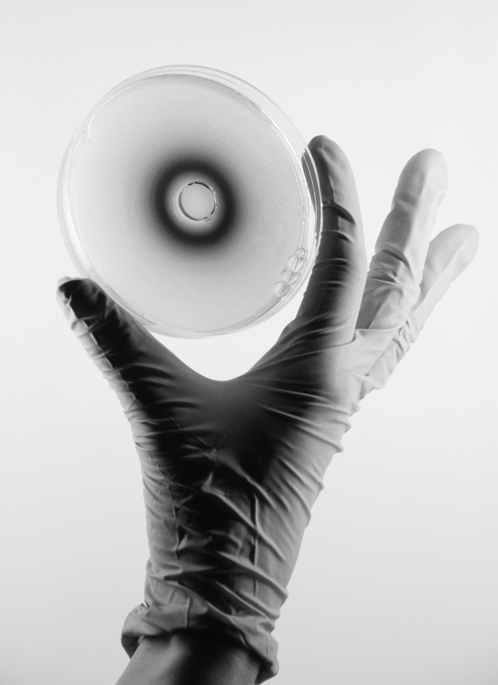
BIOSPACE — STUDIO
SUSTAIN: HELP US RELY ON SUSTAINABLE ENERGY/SOURCES
HARVEST: HARVEST THE POWER OF MICROORGANISMS AND BIOTECHNOLOGY
INSPIRE: PROVIDE NEW SPATIAL EXPERIENCES
LIQUID MOOD

Slide 5
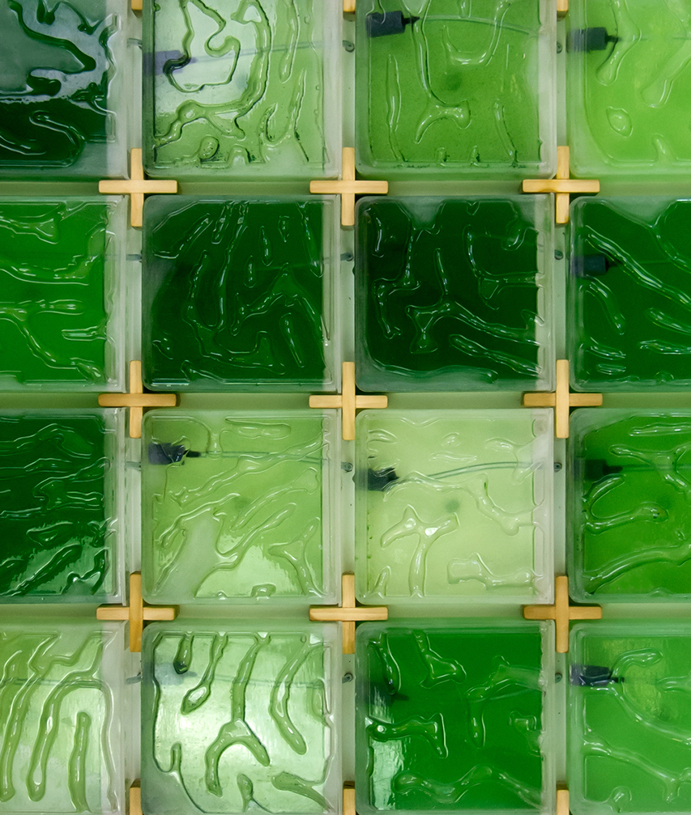
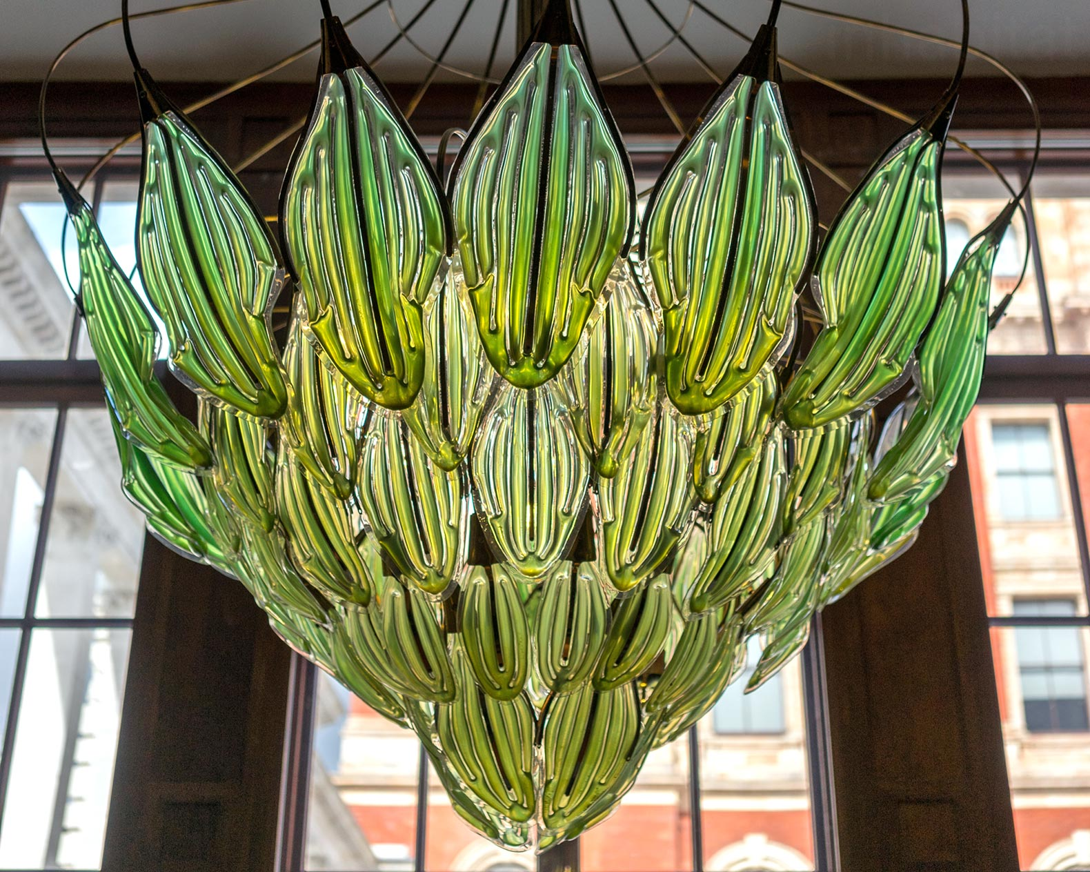
BIO-TECH
ARCH
BIOSPACE STUDIO
in
JULIAN MELCHIORRI: BIONIC CHANDELIER
HYUN SEOK AN: THE CORAL FARM
CESARE GRIFFA: WATERLILLY 2.0

Slide 6
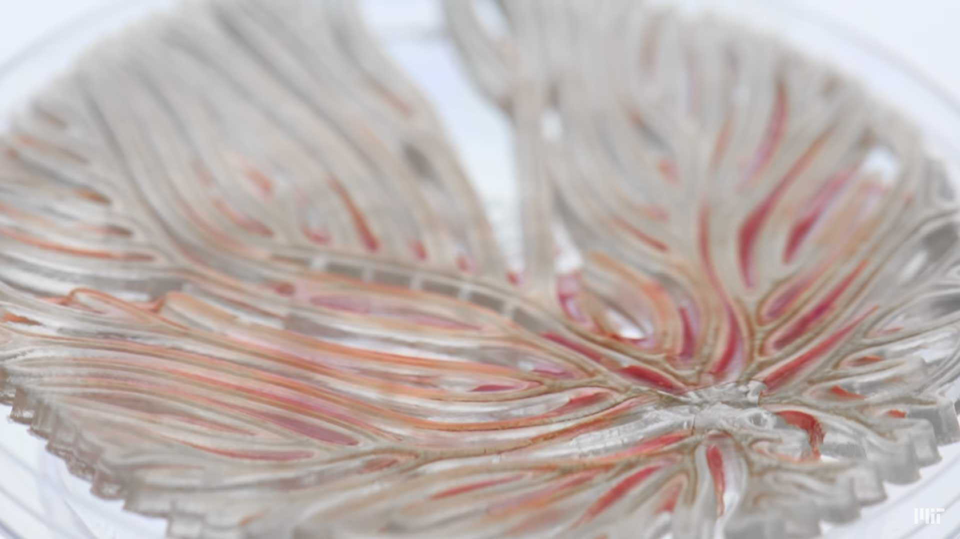
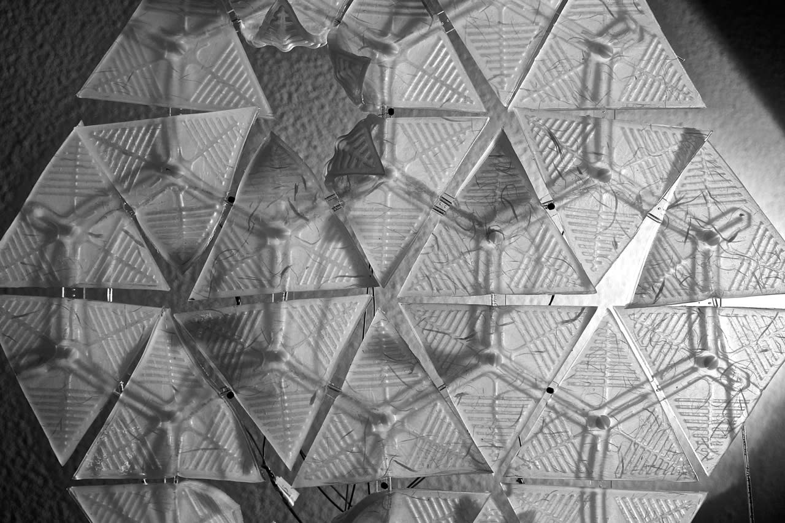
HYBRID LIVING MATERIALS
FABER FUTURES
PRECEDENTS
SOFT ROBOTIC BUILDING SKINS PROTOTYPE

Slide 7
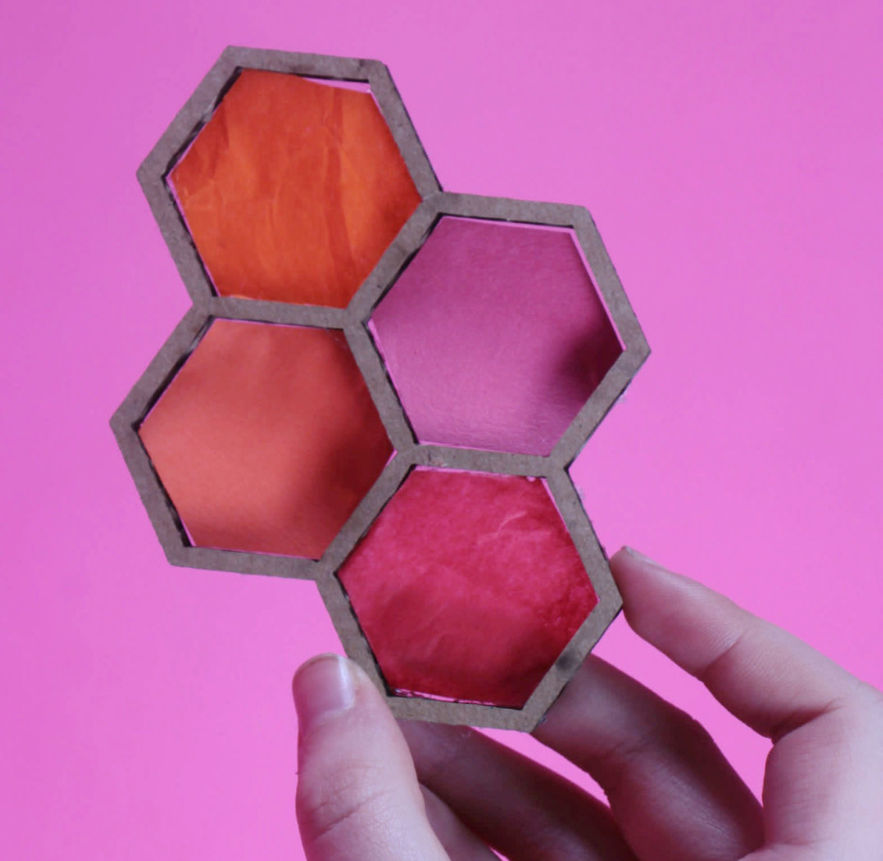
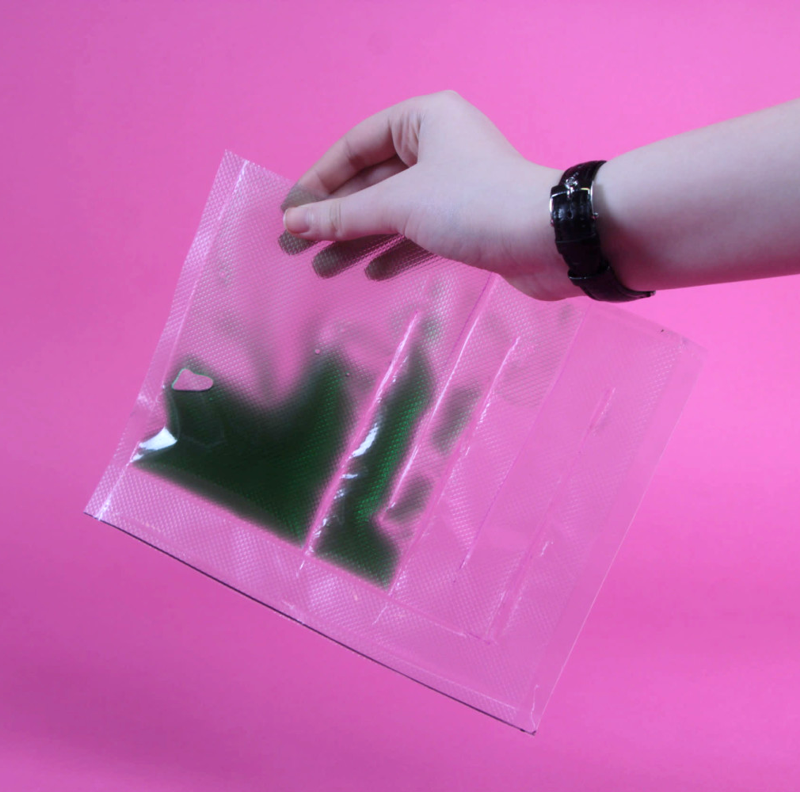
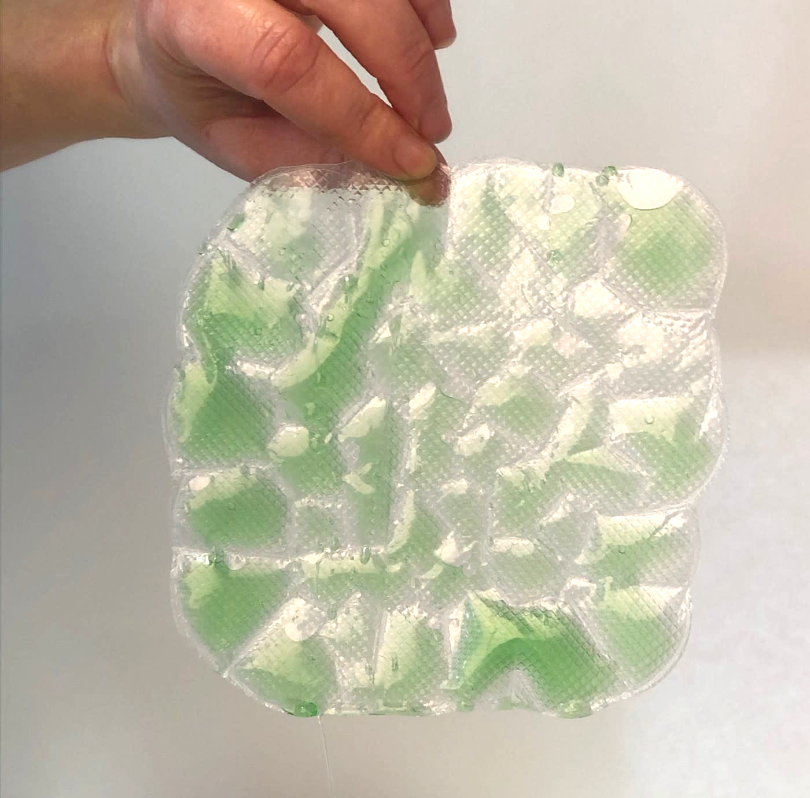
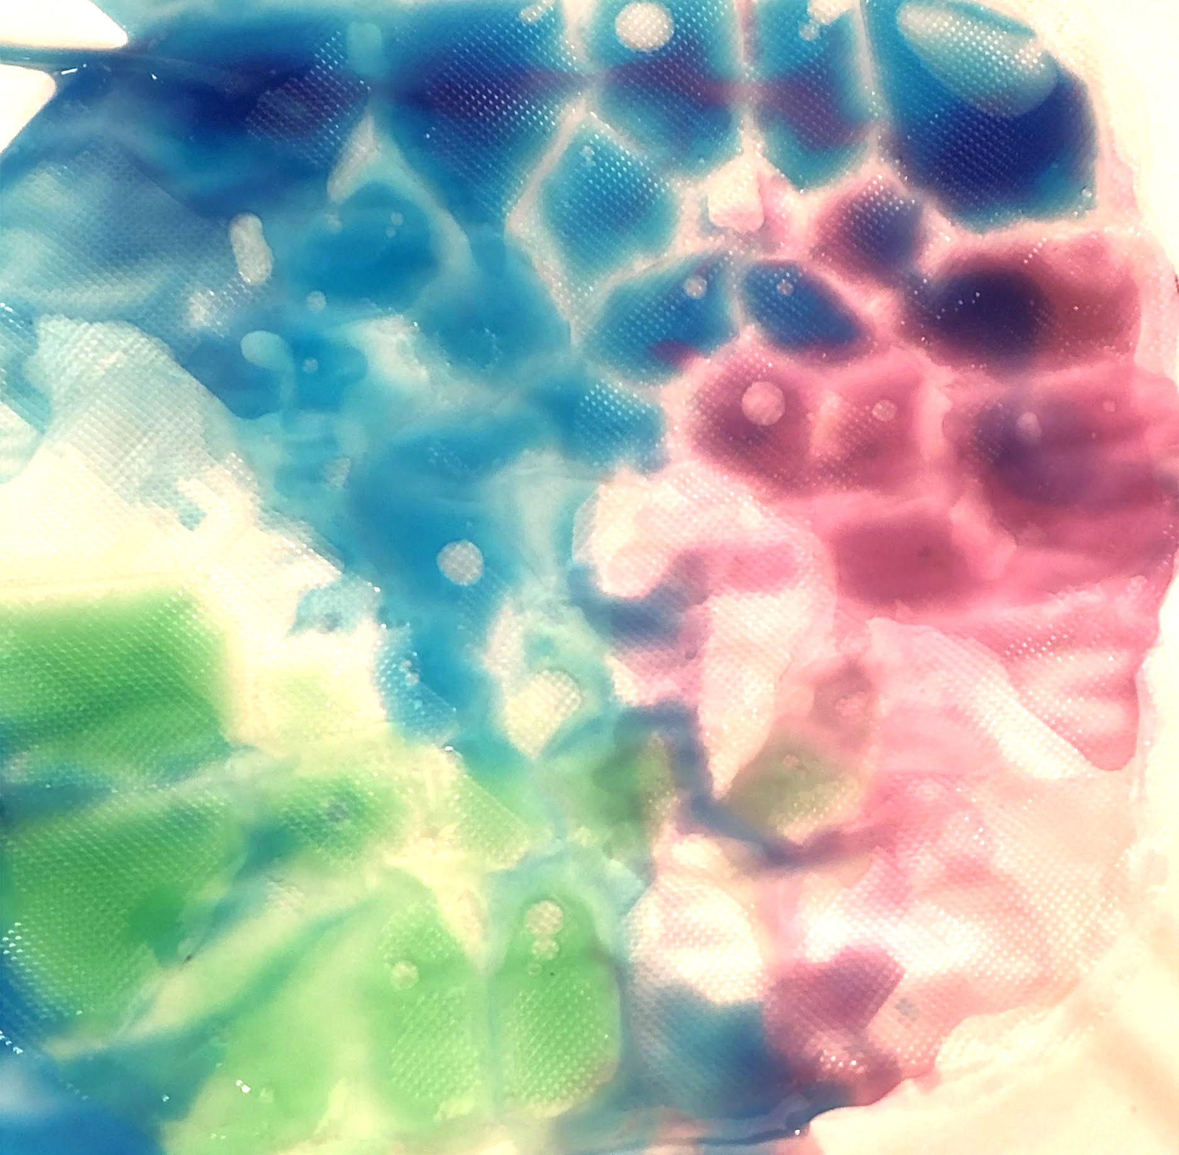
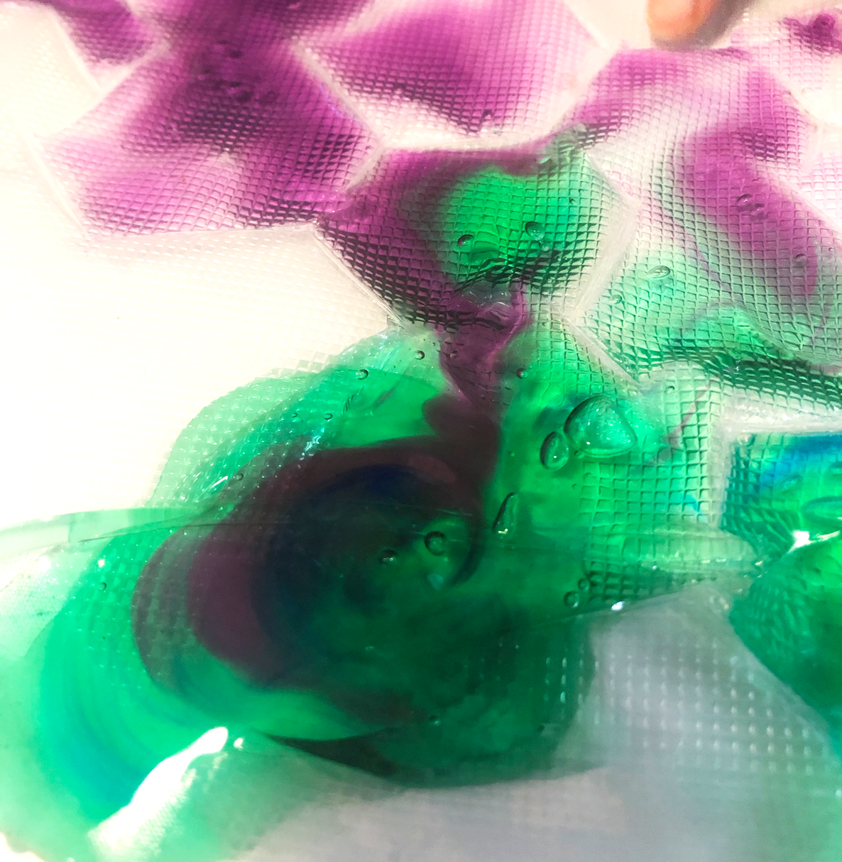
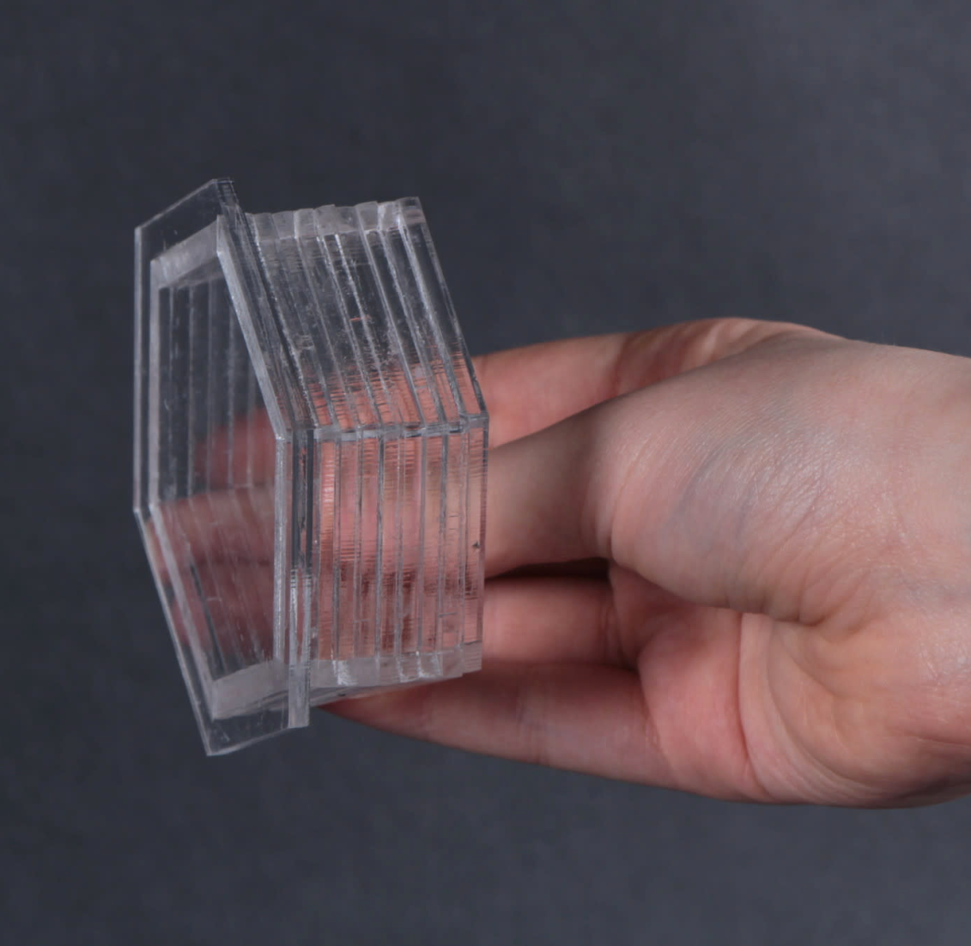
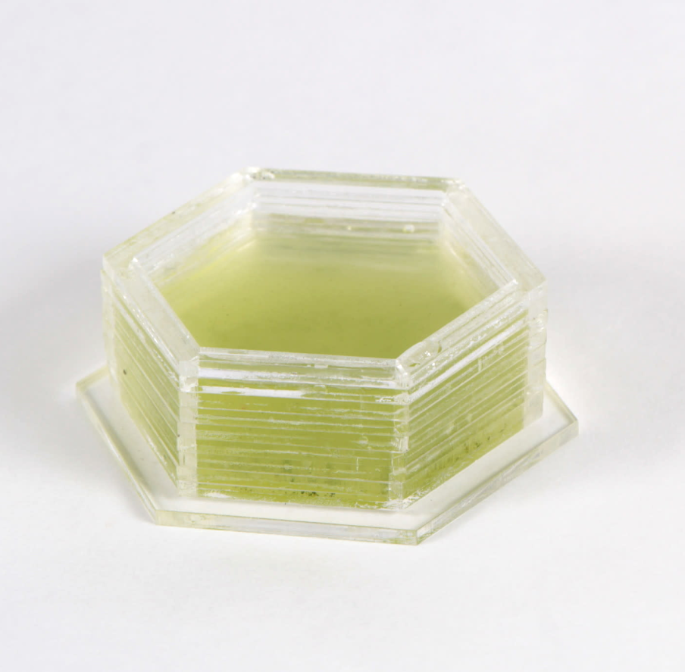
Prototypes

Slide 8
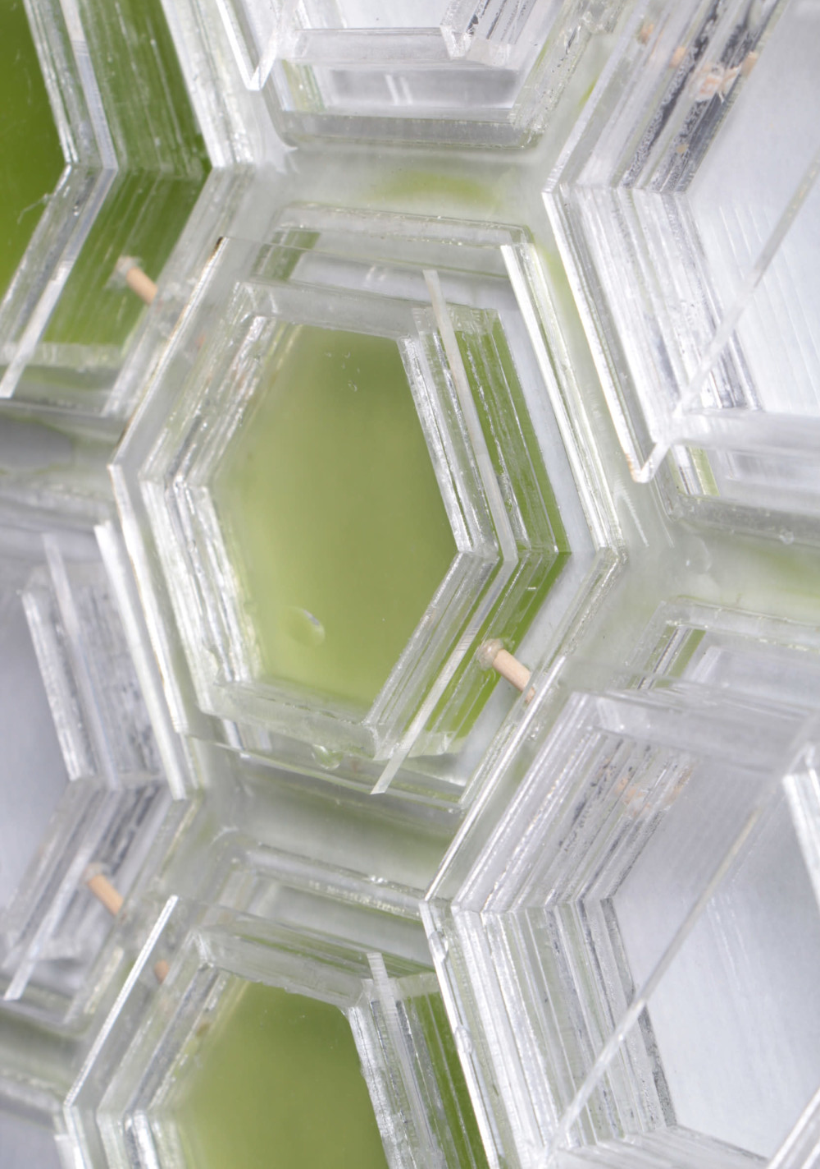
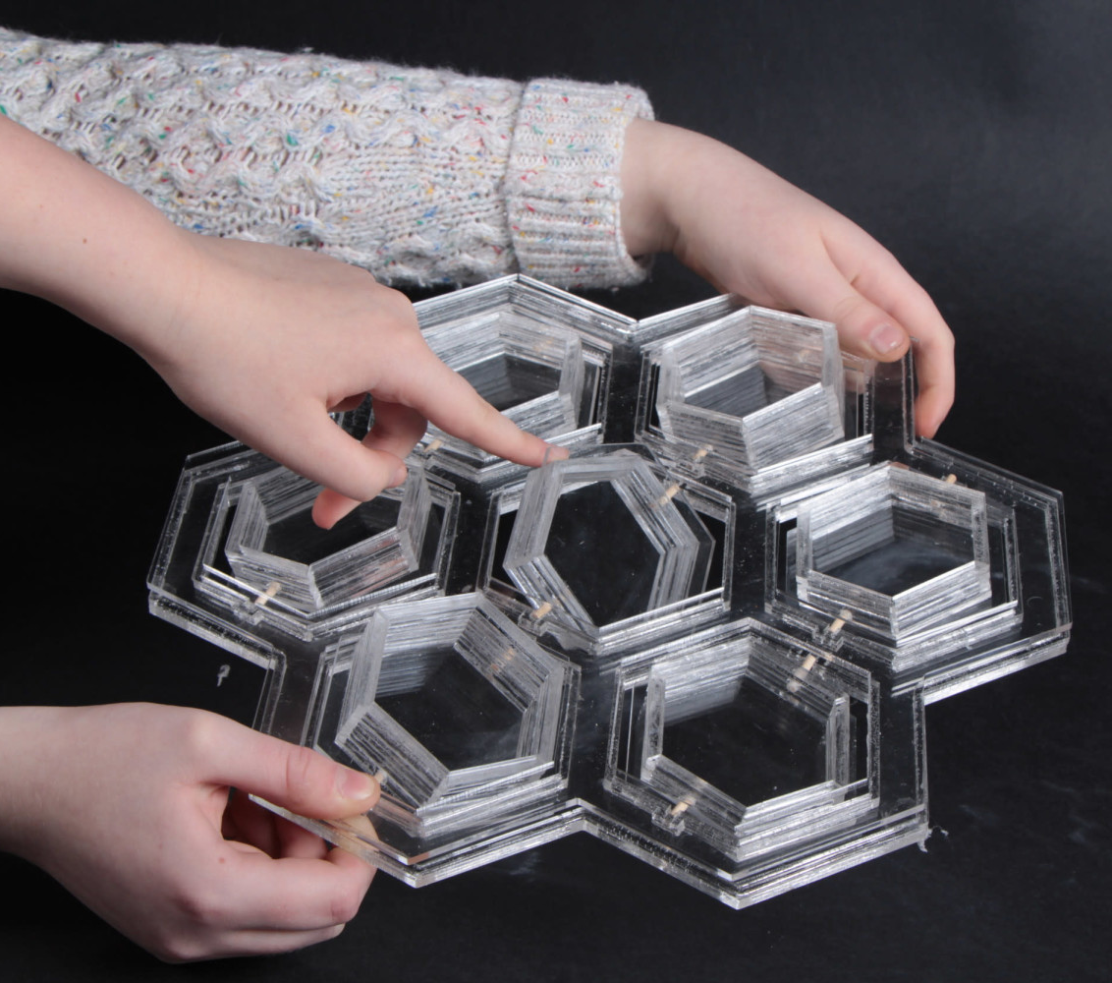
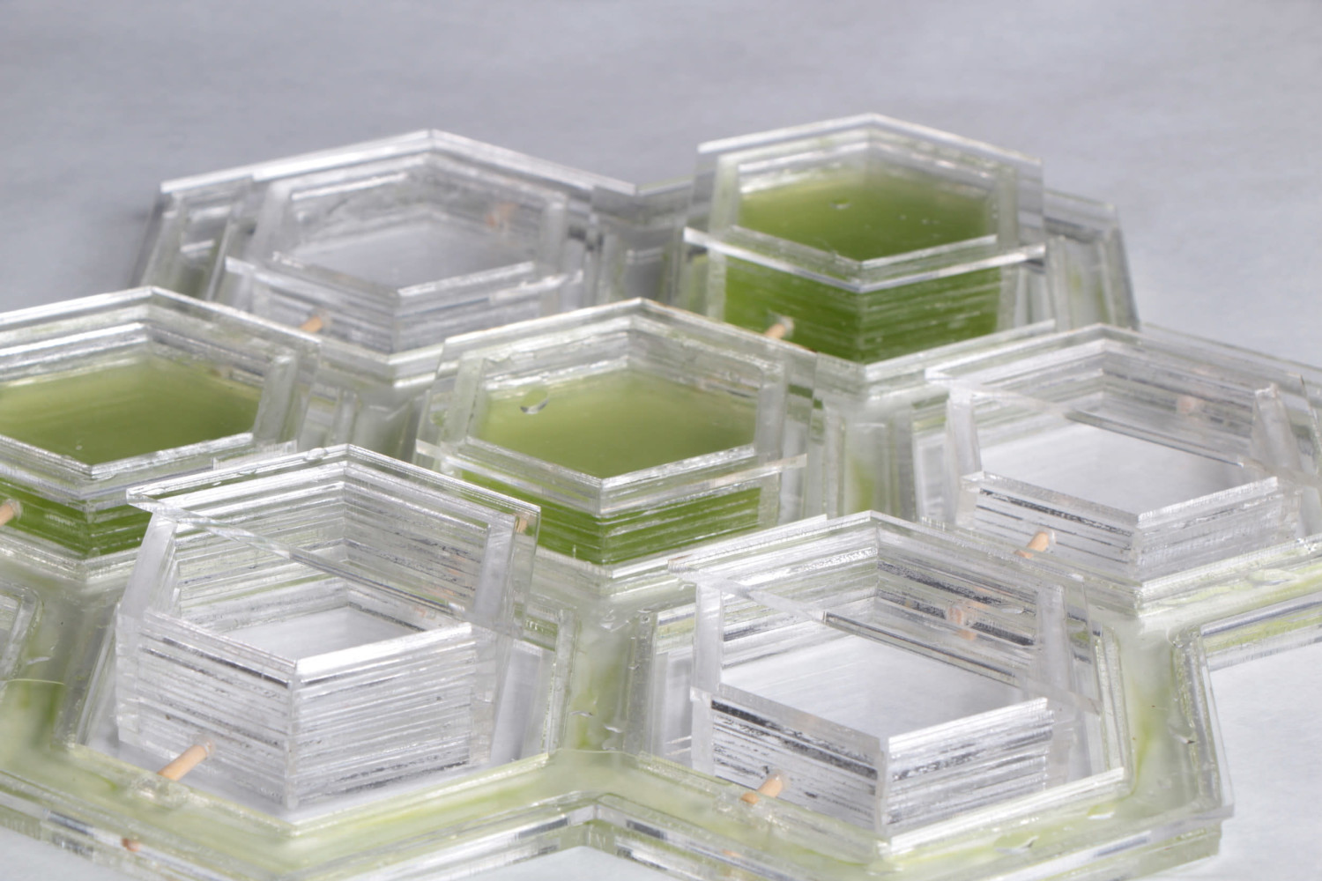
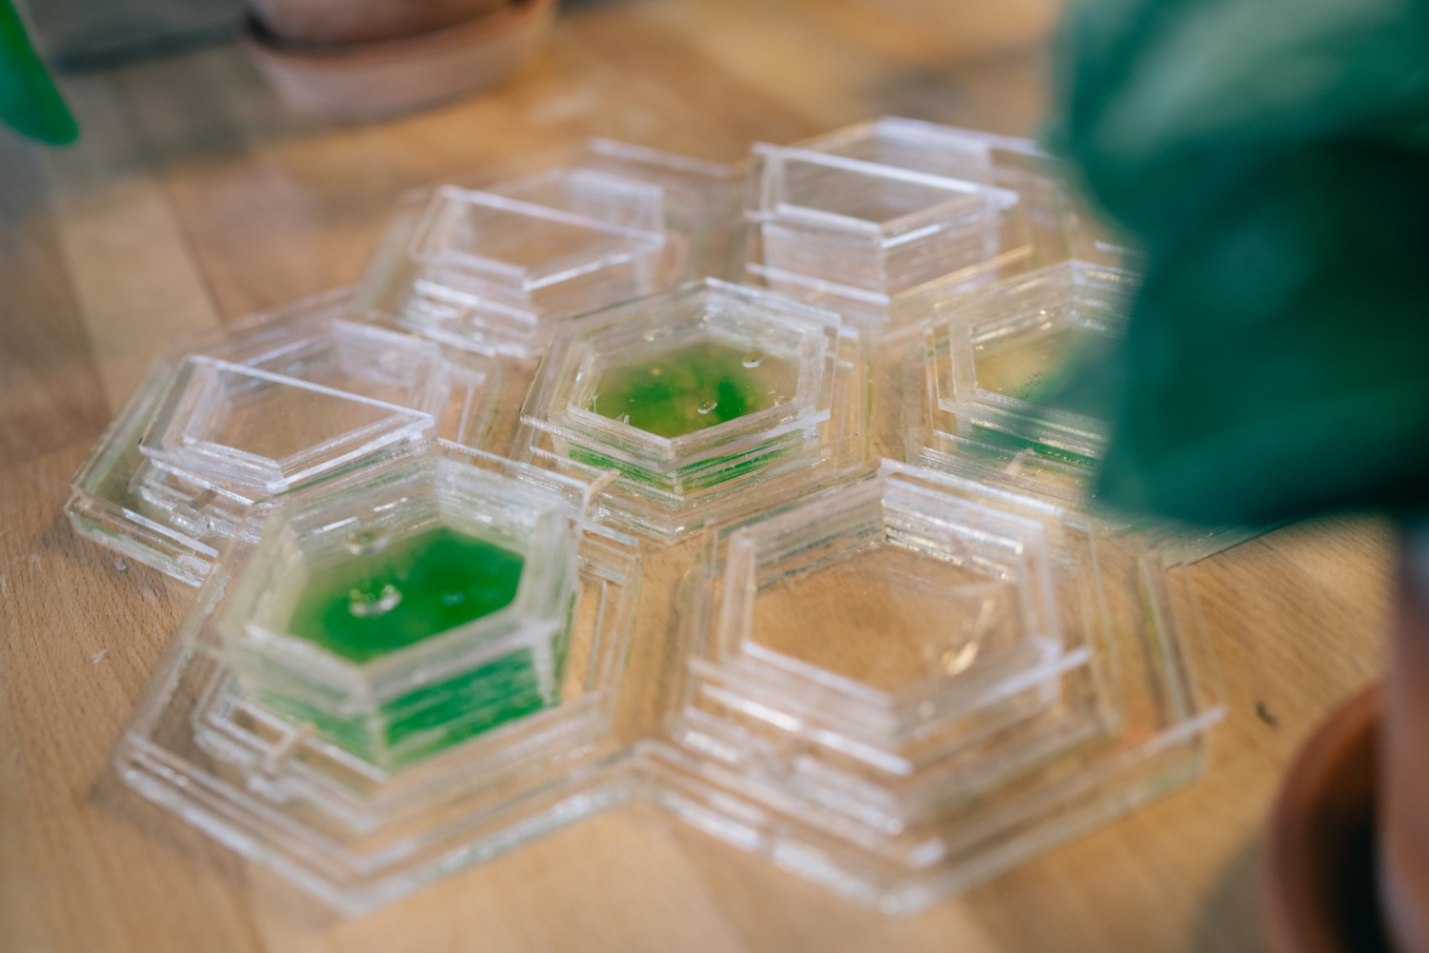
FINAL BUILD

Slide 9
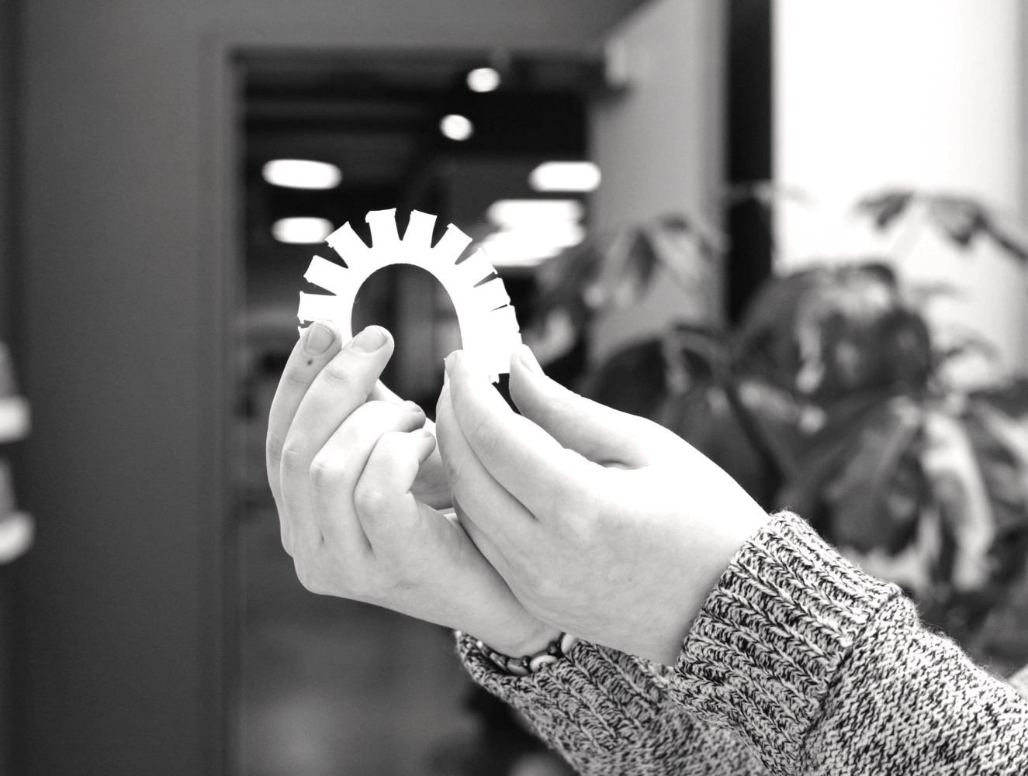
OPEN —
INNOVATION
SUSTAIN: HELP US RELY ON SUSTAINABLE ENERGY/SOURCES
HARVEST: HARVEST THE POWER OF MICROORGANISMS AND BIOTECHNOLOGY
INSPIRE: PROVIDE NEW SPATIAL EXPERIENCES
THE BIO-ACTUATION INTERACTIVE INTERFACE

Slide 10
SENSORY
STIMULATION
FOR COGNITIVE PERFORMANCE
Studies show that colors, breaks for sensorial engagement, and design and architecture impact mental health.

Slide 11
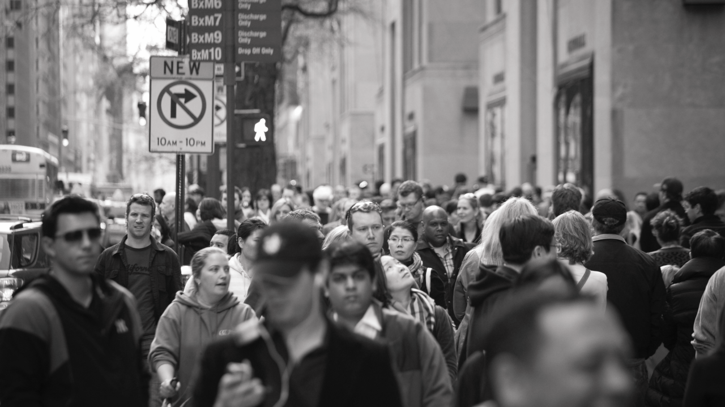
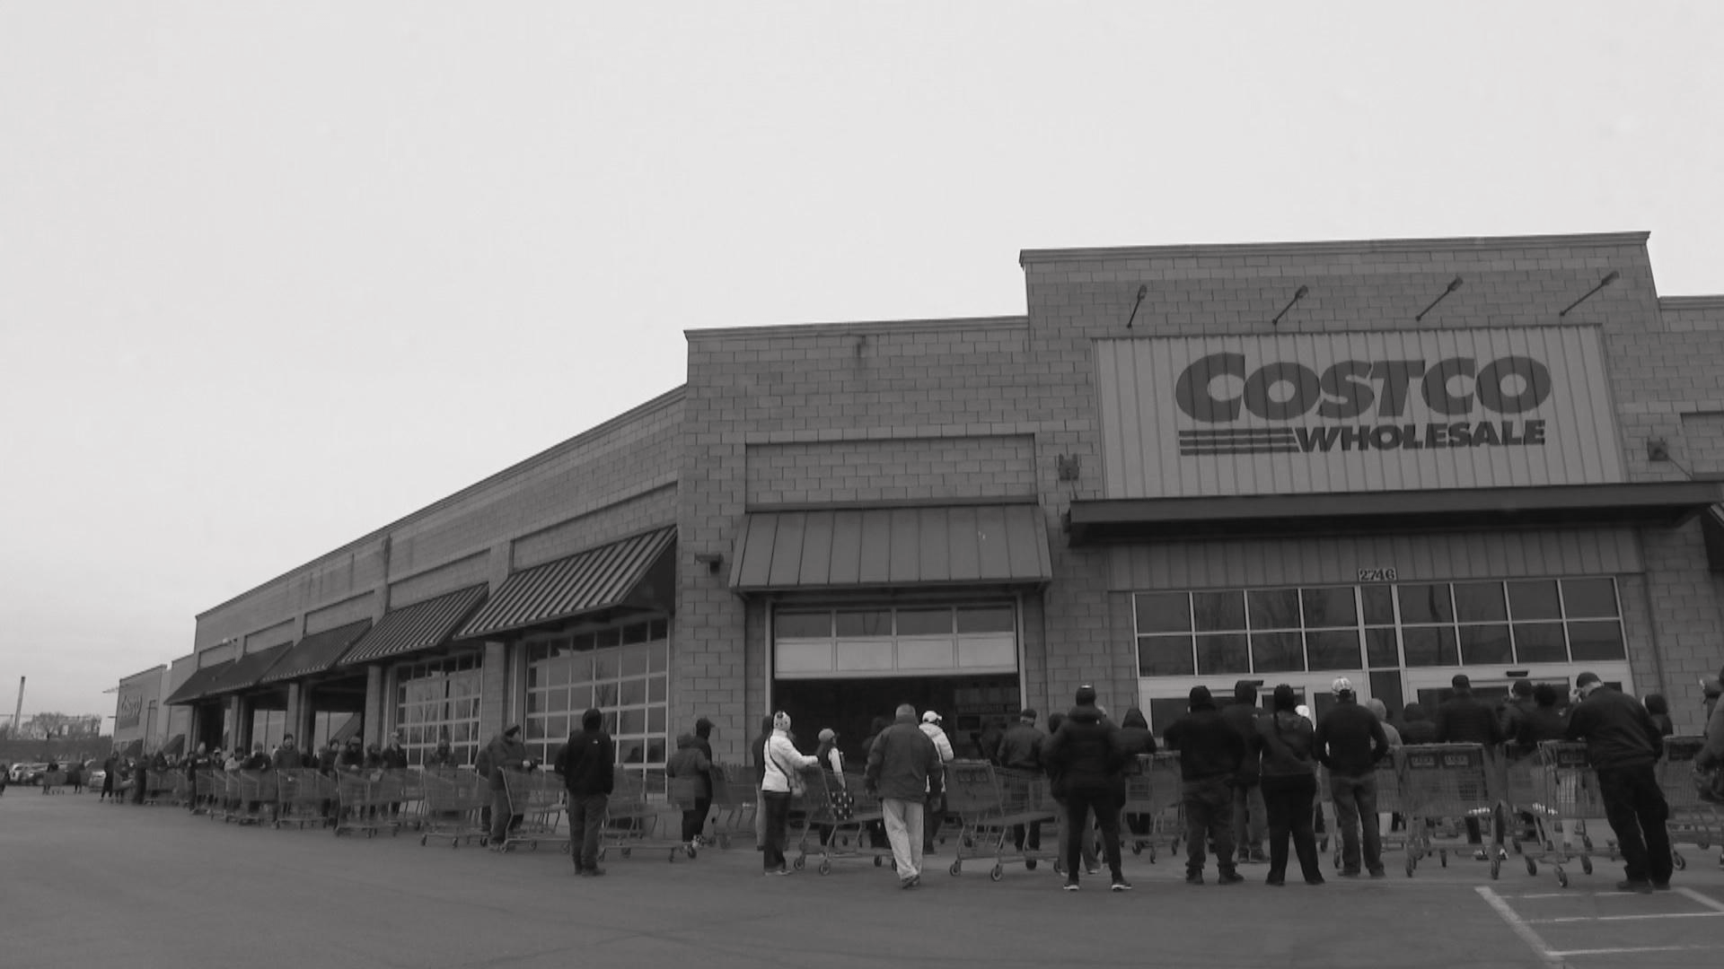
Pre-existing Risk Factors
Social drift engenders a population who are particularly predisposed to mental disorders.
CITIES & MENTAL
— HEALTH
Social Factors
Low social cohesion and crime victimisation have been found to increase the risk of psychosis in childhood.
Environmental Factors
The urban setting can affect people in two ways: increasing stimuli, and stripping away of protective factors.

Slide 12
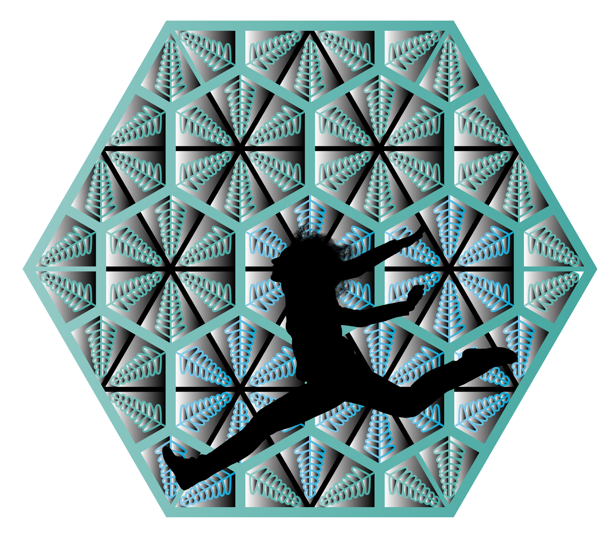
Abstract
In cities, masses of individuals cooperate to travel within pre-established ranges of motion; the vessel, or city, is unresponsive to each existence. Individuals muted by the city's bustle inevitably seek a sense of presence, an amplification to rejoice in their uniqueness. Permanently fixed frameworks and outlined trajectories construct urban environments, through apparent, unambiguous forms and stationary walls. All physical barriers are obstacles that create predefined, stationary routes that humans are forced to adapt to, muffling the ability for humans to be present and perceive the world through the full scope of their senses.
Curated to break down barriers among everyday objects and biology, the Bio-Actuation Interactive Interface allows humans to 'communicate' with bacteria and watch the space around them morph. The bacteria showcased are genetically engineered to secrete color, the output of a chemical reaction. The interface enhances the user's state of mind as the color that the bacteria secretes is programmed for specific times of the day, evoking certain feelings, responses, and emotions, formulating a positive image for biotechnology.
“ The Bio-Actuation Interactive Interface | CB ”

Slide 13
My
a.
Educate
How can biology power the future?
Why is biodesign important today?
How can people engage with bacteria, something that is often stigmatized?
c.
Create the ‘Undefined’
Enliven Public Spaces
INTENTIONS
b.
How do we define objects?
What curations can not easily be described?
How can public spaces engage the senses?
How can bio-interactivity be optimized to its capacity?
How can urban spaces be reimagined and improved?
How can installations improve people’s moods?
How can installations evoke positive feelings and emotions that can be translated into the workplace?
Could an installation help individuals to improve their quality of work, productivity, and overall success?

Slide 14
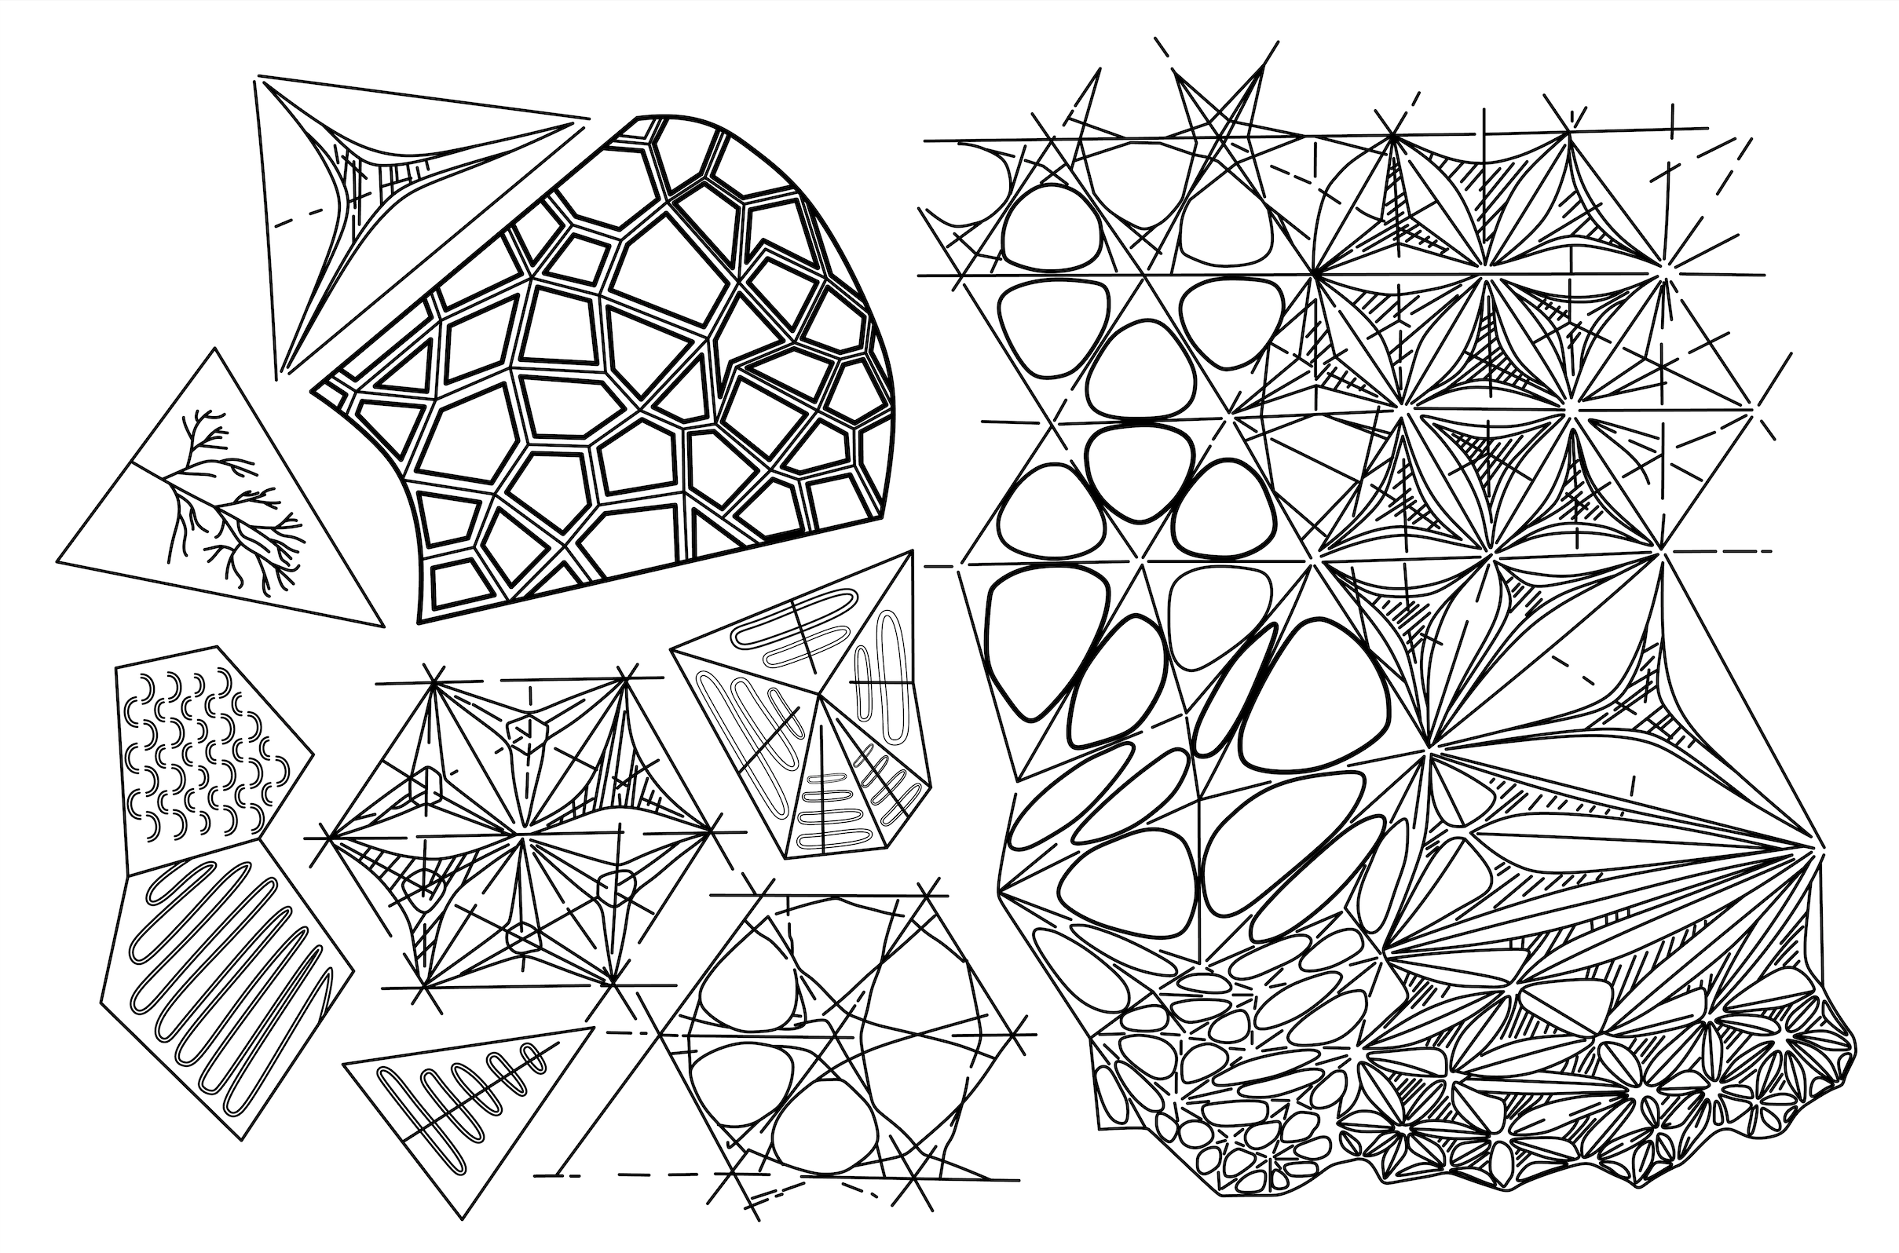

Slide 15
Silicone Molds

Slide 16
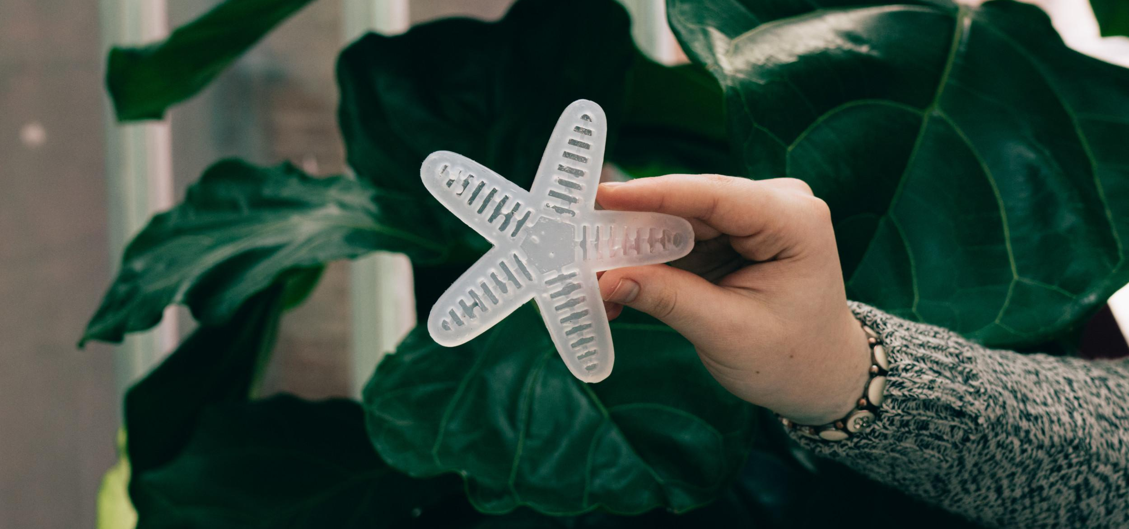
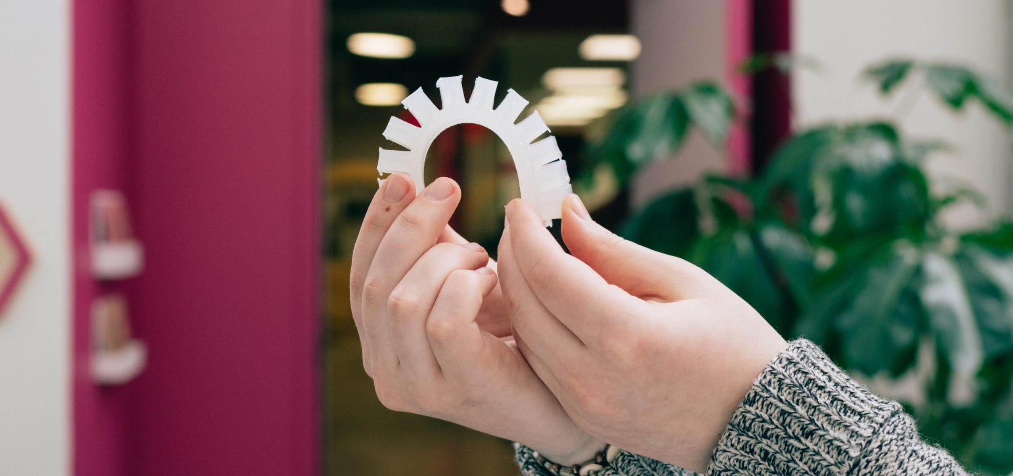
ACTUATORS

Slide 17
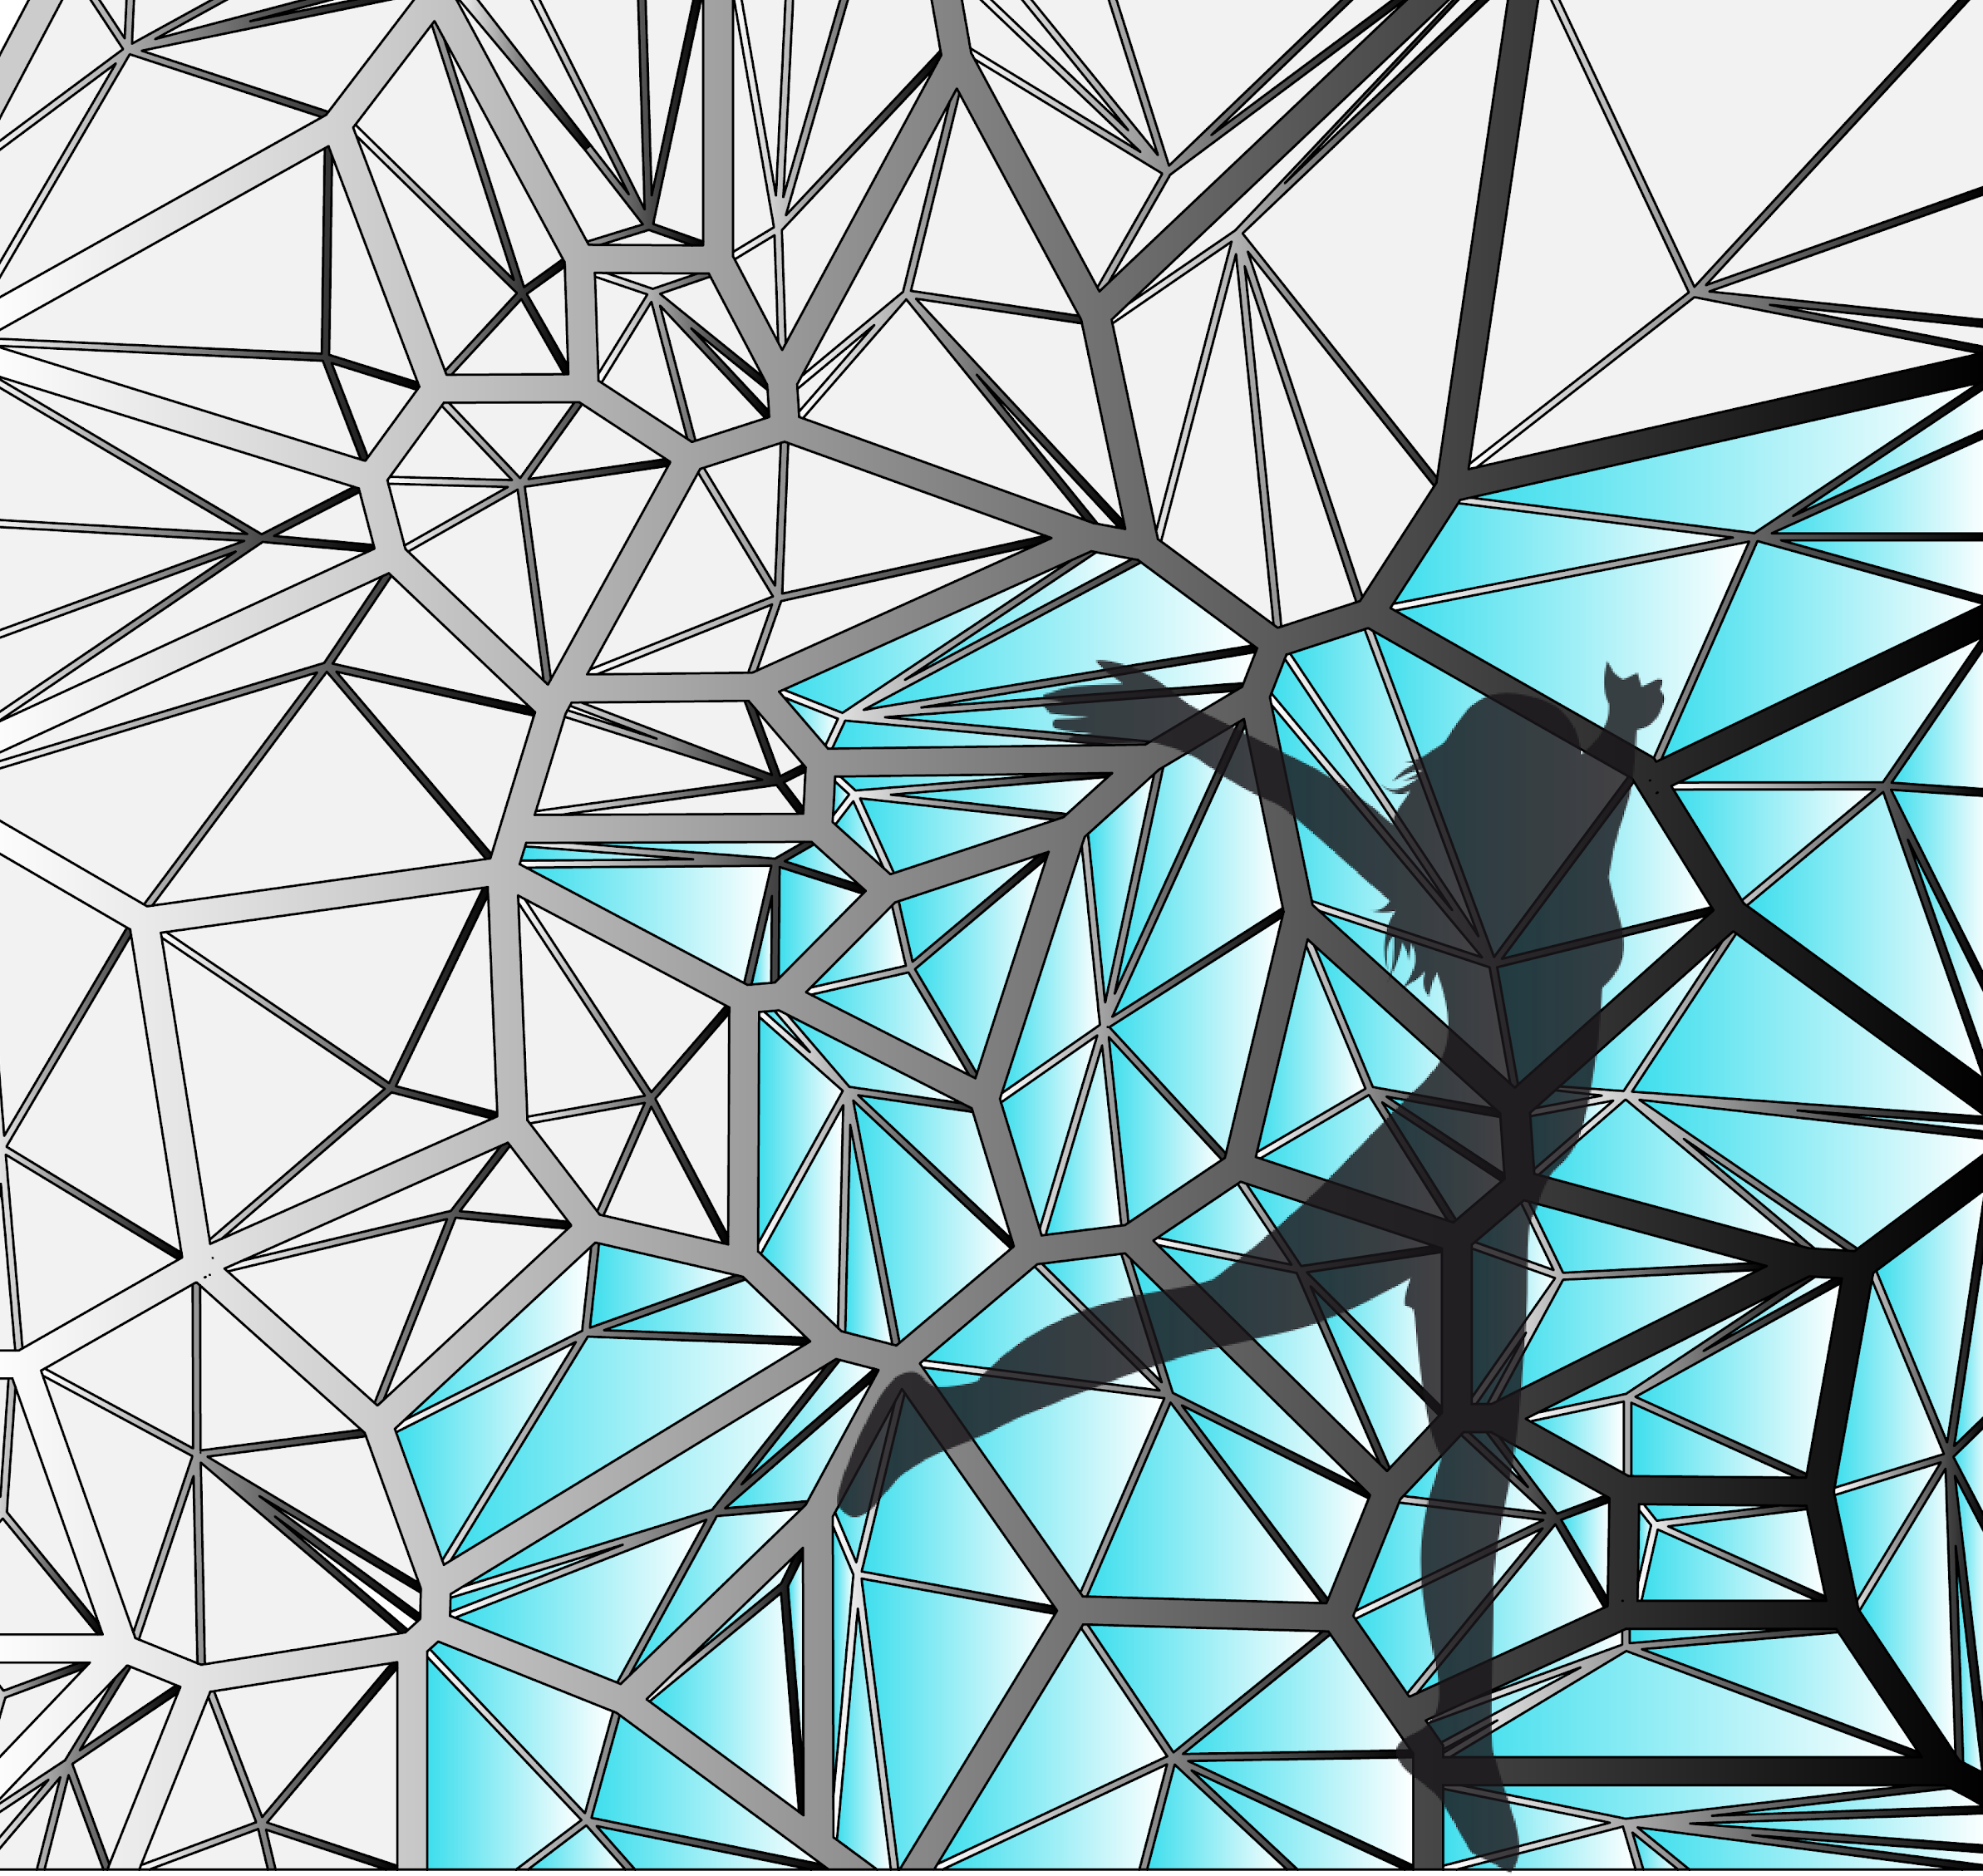
Designs

Slide 18
Gardiner, Joey. “City-Dwellers Are Prone to Depression – Are High-Rises to Blame?” The Guardian, Guardian News and Media, 16 Mar. 2017, www.theguardian.com/sustainable-business/2017/mar/16/cities-depression-stress-mental-health-high-rises-urban-design-london-toronto.
Bond, Michael. “The Hidden Ways That Architecture Affects How You Feel.” BBC Future, BBC, 5 June 2017, www.bbc.com/future/article/20170605-the-psychology-behind-your-citys-design.
Reynolds, Emily. “Could Bad Buildings Damage Your Mental Health?” The Guardian, Guardian News and Media, 16 Sept. 2016, www.theguardian.com/cities/2016/sep/16/bad-buildings-damage-mental-health-research-anxiety-depression.
“How School Design and Architecture Can Impact Students' Mental Health.” LAN Associates, 20 Jan. 2020, lanassociates.com/news/how-school-design-and-architecture-can-impact-students-mental-health.
Frieden, Joyce. “Can Prison Design Affect Inmates' Mental Health Outcomes?” Medical News and Free CME Online, MedpageToday, 7 July 2020, www.medpagetoday.com/meetingcoverage/aapl/76054.
Yildirim, K., et al. “Effects of Indoor Color on Mood and Cognitive Performance.” Building and Environment, Pergamon, 4 Oct. 2006, www.sciencedirect.com/science/article/abs/pii/S0360132306002289.
Citations

Slide 19
“How the City Affects Mental Health.” Centre for Urban Design and Mental Health, www.urbandesignmentalhealth.com/how-the-city-affects-mental-health.html.
Kohll, Alan. “New Study Shows Correlation Between Employee Engagement And The Long-Lost Lunch Break.” Forbes, Forbes Magazine, 30 May 2018, www.forbes.com/sites/alankohll/2018/05/29/new-study-shows-correlation-between-employee-engagement-and-the-long-lost-lunch-break/#4942773c4efc.
Anderson, Julie. “The Impact of Sensory-Based Movement Activities on Students in General Education.” Sound Ideas, University of Puget Sound, July 2016, soundideas.pugetsound.edu/cgi/viewcontent.cgi?article=1001&context=drot_theses.
Ellard, Colin. “Why Boring Streets Make Pedestrians Stressed and Unhappy – Colin Ellard: Aeon Essays.” Aeon, Aeon Media Group, 8 July 2020, aeon.co/essays/why-boring-streets-make-pedestrians-stressed-and-unhappy.
Valverde, Isabel. “Senses Places: Soma-Tech Mixed-Reality Participatory Performance Installation/Environment.” ACM Digital Library, 1 Sept. 2017, dl.acm.org/doi/abs/10.1145/3106548.3106613.
Citations

Slide 20
Loke, Lian. “Bodily Experience and Imagination: Designing Ritual Interactions for Participatory Live-Art Contexts.” ACM Digital Library, June 2012, dl.acm.org/doi/10.1145/2317956.2318073.
Veronesi, Francesca. “Curating the Sensorial: Digital Mediation and Social Engagement with Place, Objects and Intangible Heritage.” Academia.edu, 2013, www.academia.edu/20056677/Curating_the_sensorial_digital_mediation_and_social_engagement_with_place_objects_and_intangible_heritage.
Hutson, Matthew. “Beyond the Five Senses.” The Atlantic, Atlantic Media Company, 20 June 2017, www.theatlantic.com/magazine/archive/2017/07/beyond-the-five-senses/528699/.
Fritzsch, Bernd. “Opinion: Acquiring Extra Senses.” The Scientist Magazine®, 31 Aug. 2016, www.the-scientist.com/thought-experiment/opinion-acquiring-extra-senses-32947.
Kobie, Nicole. “Why Stop at Five Senses? Tech Is Letting Us Hack Our Brains to Give Us 'Superpowers'.” WIRED, WIRED UK, 25 Aug. 2016, www.wired.co.uk/article/hacking-senses-adding-more.
Bradford, Alina. “The Five (and More) Senses.” LiveScience, Purch, 24 Oct. 2017, www.livescience.com/60752-human-senses.html.
Citations

Slide 21
“We Have More Than Five Senses; Most People Take the Faculties of Sight, Touch, Smell, Taste and Hearing for Granted-but Not the Scientist. Recent Findings Suggest We May Have Abilities We Never Suspected.” The New York Times, The New York Times, 15 Mar. 1964, www.nytimes.com/1964/03/15/archives/we-have-more-than-five-senses-most-people-take-the-faculties-of.html.
Javelosa, June. “Could We Hack Our Brains to Gain New Senses?” Futurism, Futurism, 16 Dec. 2016, futurism.com/could-we-hack-our-brains-to-gain-new-senses.
Elliot , Andrew J., and Markus A. Maier. “Color Psychology: Effects of Perceiving Color on Psychological Functioning in Humans.” Annual Reviews, 26 June 2013, www.annualreviews.org/doi/pdf/10.1146/annurev-psych-010213-115035.
Akers, Adam, et al. “Visual Color Perception in Green Exercise: Positive Effects on Mood and Perceived Exertion.” ACS Publications, American Chemical Society, 2 Aug. 2012, pubs.acs.org/doi/abs/10.1021/es301685g#.
Citations

